Slide 1
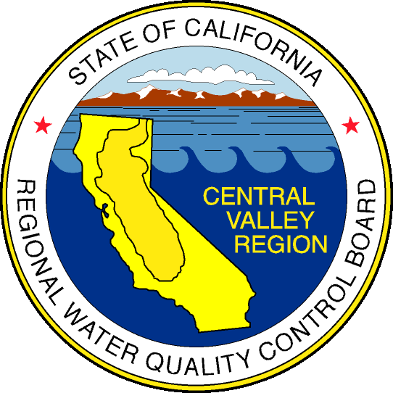
Central Valley Regional Water Quality Control Board Water Quality Monitoring Activities
in Sacramento County
Alisha Wenzel
Surface Water Ambient Monitoring Program
June 18, 2018 Presentation to Sacramento Environmental Commission Slide 1

Slide 2
State and Regional Water Boards
Mission to preserve, enhance, and restore the quality of California’s water resources and drinking water

Slide 3
Surface Water Ambient Monitoring Program
The SWAMP mission is to provide resource managers, decision makers, and the public with timely, high quality information to evaluate the condition of California’s waters.
Statewide and regional monitoring programs
Monitoring efforts are prioritized
Comparable data: standardized methods, quality assurance, data reporting

Slide 4
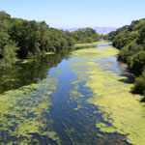
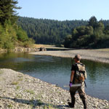
SWAMP Statewide Monitoring Programs
Bioaccumulation
Bioassessment
Freshwater HABs
Stream Pollution Trends

Slide 5
SWAMP Statewide Monitoring Programs
Bioaccumulation
Bioassessment
Streams & Rivers Portal
Freshwater HABs
Stream Pollution Trends

Slide 6
Bioaccumulation
Bioaccumulation Oversight Group
Monitors contaminants in sport fish
2007-2012: Lakes, rivers, and coastal waters
2015: Long-term plan for mercury in bass lakes
190 lakes on 10-year cycle
https://mywaterquality.ca.gov/safe_to_eat/

Slide 7
Mercury in Largemouth Bass

Slide 8
What’s Being Done?
OEHHA Fish Consumption Advisories
Folsom Lake, Lake Natoma, Lower American & Cosumnes Rivers, and Delta
303d List of Impaired Water Bodies
Total Maximum Daily Loads (TMDLs)
Sacramento-San Joaquin Delta
Mercury Exposure Reduction Program
Delta Regional Monitoring Program
Statewide Control Program for Reservoirs
Folsom, Natoma, and Beach Lakes

Slide 9
Freshwater Harmful Algal Blooms
Works closely with the California Cyanobacteria Harmful Algal Bloom Network (CCHAB)
Voluntary guidance for posting & notification
Coordinate bloom reporting & follow up
Limited resources
Guidance documents, field & lab procedures
https://mywaterquality.ca.gov/habs/

Slide 10
HABs Portal
Report a Bloom
Signs, Field Guide, & Resources
HAB Incident Reports
HAB Data Viewer

Slide 11
Central Valley Recreational Beneficial Use Assessment
Evaluate whether Recreation Beneficial Uses are protected
Data gap—no comprehensive program for freshwater beaches
Targeted swimming holes and beaches
Sampling primarily during the summer months
Monitoring design evolved and expanded over time

Slide 12
Assessment Thresholds
EPA 2012 Recreational Water Quality Criteria
Criteria Elements | Recommendation 1 Estimated Illness Rate 36/1,000 |  | Recommendation 2 Estimated Illness Rate 32/1,000
Indicator | GM | STV | GM | STV
Enterococci | 35 | 130 | 30 | 110
E. coli | 126 | 410 | 100 | 320
*Proposed Statewide Bacteria Objectives
Geometric Mean (GM): not to be exceeded by a 6-week rolling geometric mean of 5+ samples, calculated weekly
Statistical Threshold Value (STV): not to be exceeded by >10% of samples in a calendar month

Slide 13
Recreational Sites Sampled 2007-2016

Slide 14
American River
Lower American River Sampling Stations 2007-2016

Slide 15
Summary of E. coli Data for Each Station
Number of Assessments
Confluence
Nimbus
49% > Criteria
4% > Criteria

Slide 16
Current Recreational Monitoring
Weekly monitoring since January
9 sites on the American River
2 sites near the mouth of Steelhead Creek
Goals:
Update the public about water quality conditions
Inform development of source identification study
Summer recreation assessment in Sacramento River

Slide 17
Online Map with E. coli Results

Slide 18
Access to Monitoring Data
E. coli and Healthy Swimming Habits
www.sacparks.net/healthyswimming
Interactive map with weekly monitoring results
California Environmental Data Exchange Network
www.ceden.org
California Water Quality Monitoring Council
Efforts to update the Safe to Swim Portal
Inland Beaches Workgroup
www.mywaterquality.ca.gov

Slide 19
Improve Communication & Notification
New Notification Protocol
Notify local Environmental Health Directors of elevated E. coli
Improve coordination with local health officials
Ensure public is notified of potential health risk
No Current Guidance for Freshwater Beaches
Public Access to Data

Slide 20
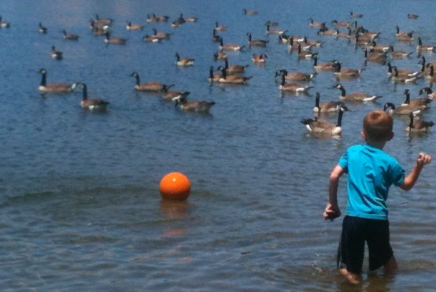
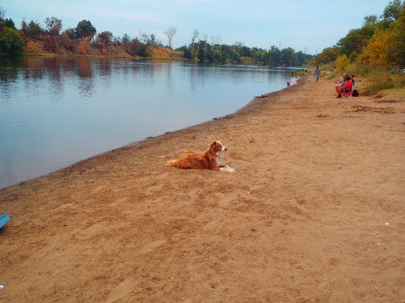
Investigative Study
Coordinating with Local Stakeholders
Investigate Elevated E. coli
Identify the Sources of Fecal Contamination
Birds, Pets, Humans
Potential Monitoring for Pathogens

Slide 21
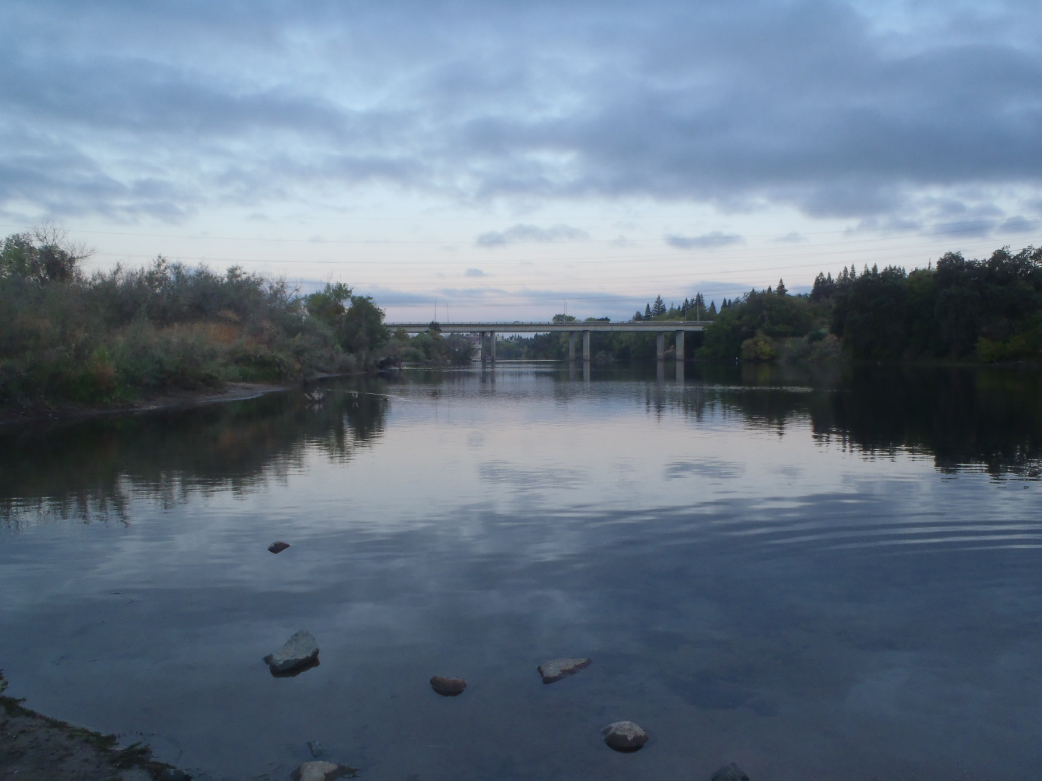
Questions?

