Slide 1
Presentation to the
Sacramento Environmental Commission
January 15, 2020

Slide 2
SMUD’s Wildfire Mitigation Plan (WMP)
Overview of SMUD’s Low Wildfire Risk Profile
Risk-based Approach
SMUD’s
Wildfire Mitigation Plan
i
WMP Requirements
De-energization Protocols

Continuous Monitoring & Evaluation
About SMUD

Slide 3
SMUD Overview
6th largest publicly owned utility in the nation
Serves Sacramento County and small portion of Placer County
900 Square Mile Service Territory
Maintains facilities in El Dorado and Solano Counties
600,000 Customers

Slide 4

Wildfire Mitigation Plan Requirements
Objectives & Responsibilities
Preventative Strategies & Programs
Metrics
Notification & Communication

Slide 5
Risk-Based Approach
Comprehensive assessment of key risk drivers and impacts of wildfire related to SMUD electric facilities
Public Outreach
Public Comment Period
Dedicated Webpage
Qualified Independent Evaluation
Comprehensive
Meets regulatory requirements and industry standards
Board Presentations/Adoption
September 11, 2019
October 17, 2019

Slide 6
i
SMUD’s WMP Objectives
SMUD’s priority is delivering safe, reliable,
environmentally sustainable and affordable power
Minimize the probability that SMUD’s transmission and distribution (T&D) system may be the origin or contributing source for the ignition of a wildfire
Implement a wildfire plan that embraces safety, prevention, mitigation and recovery as a central priority for SMUD
Create a WMP that is consistent with state law and objectives.

Slide 7
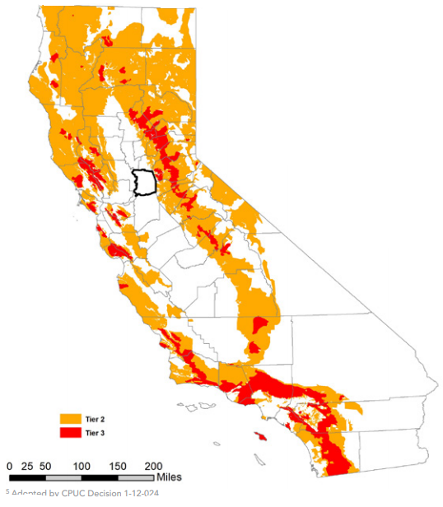
i
SMUD’s Fire Risk
SMUD’s service territory is outside CPUC High Fire Threat District.
SMUD takes all existing risk seriously and prioritizes activities in higher fire hazard zones within its service territory
Highest wildfire risk area is outside SMUD’s service territory where we maintain the Upper American River Project (UARP) in El Dorado County.
(PG&E provides electric service to end use customers in this area.)
CPUC Fire-Threat Map
Adopted January 19, 2018

Slide 8
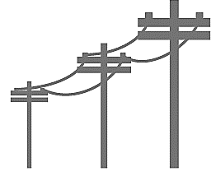
Wildfire Prevention Programs
Vegetation Management
& Fuels Reduction
Pole and wire clearing
Right of way maintenance
Design
&
Construction
Non-expulsion equipment
System upgrades
Inspection
&
Maintenance
Aerial and ground patrols
LiDAR and infrared technologies
Recloser &
De-Energization
Transmission and distribution protocols
Situational Awareness
Weather stations
Camera pilot
Education & Outage Comm.
Critical event messaging

Slide 9
Expanded Mitigation Activities
SMUD is making substantial investments
in wildfire prevention
Increased scope of vegetation management in high fire threat areas
System improvement capital projects
Non-expulsion devices and arresters with arc protection
Study to identify project to replace bare 4kV wire
Increased situational awareness
Additional weather stations in UARP
Real-time situational awareness tool
Pilot projects
Hyper spectral imagery
Fire monitoring cameras in UARP transmission corridor

Slide 10
Established Protocols for De-energization
As a last resort, SMUD will de-energize lines to protect the safety of our communities under the following:
If requested by first responders; or
When SMUD system operators identify an active wildfire or extreme fire risk near a power line
SMUD will communicate to first responders, local agencies, service providers and customers to provide early notice of power shut-off when possible.

Slide 11
SMUD website: www.smud.org/WildfireSafety
Contact: wmp@smud.org

