Slide 1
California State University Sacramento Sustainability
Josh Maddox

Slide 2
What We Do
Water Use
Energy
Waste Diversion/Reduction
Reduce overall GHG Emissions

Slide 3
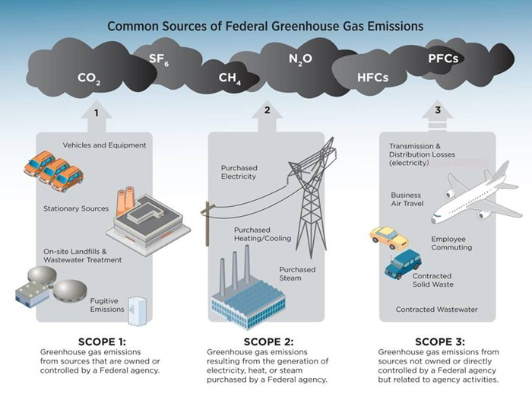
Emission Scopes

Slide 4
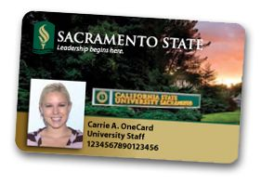
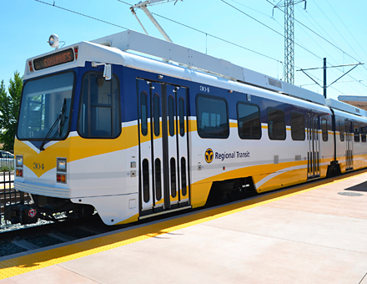
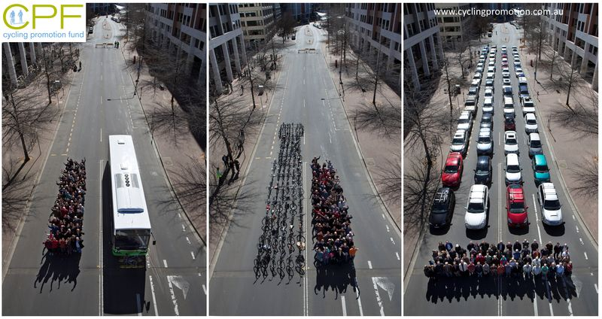
Transportation
All the cars with one person versus public transportation
OneCard

Slide 5
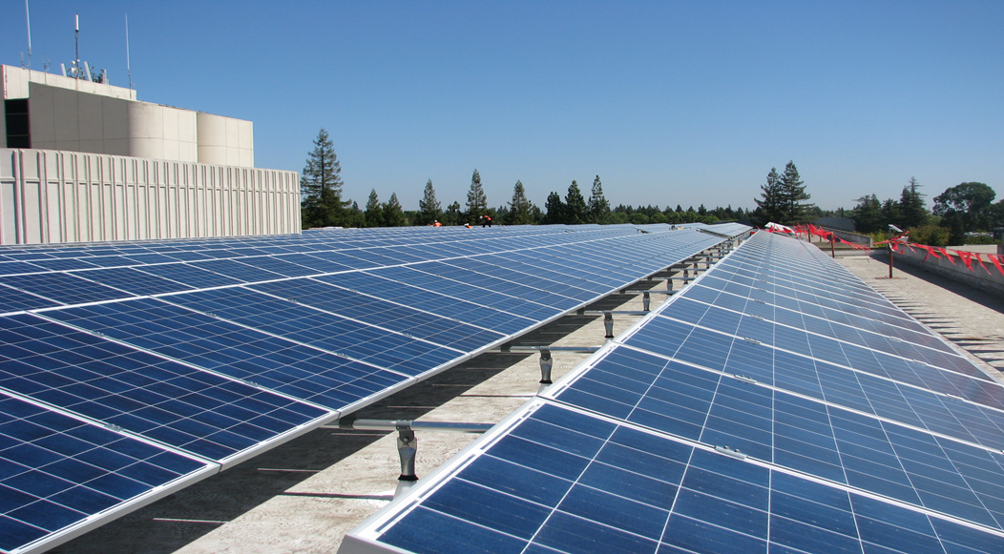
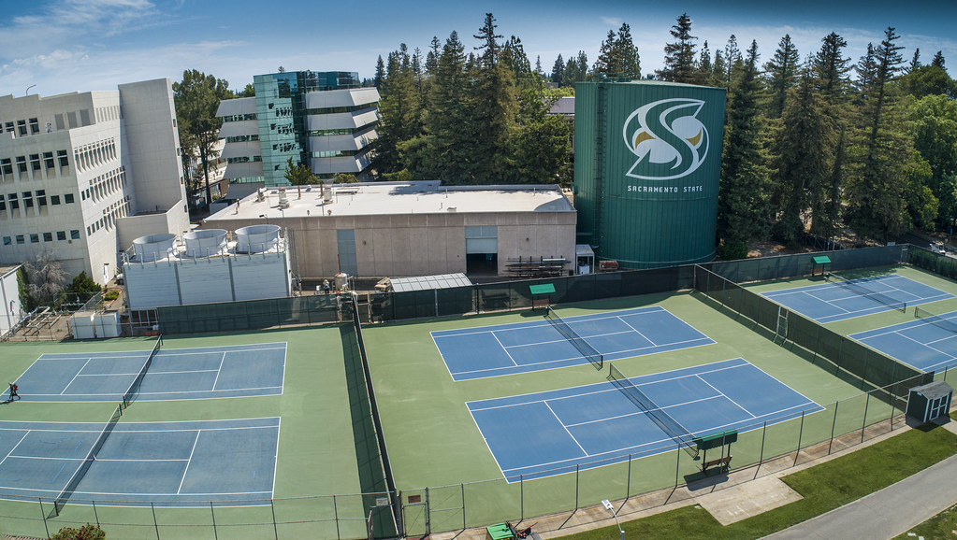
Energy
Lighting Retrofits in existing buildings
SMUD’s Auto-Demand Response (ADR) Program
Chilled Water Tower
Renewable Energy

Slide 6
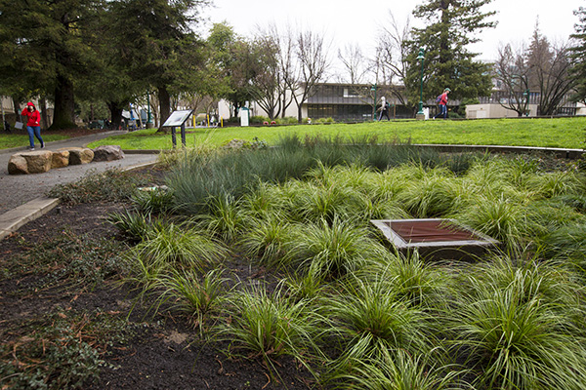
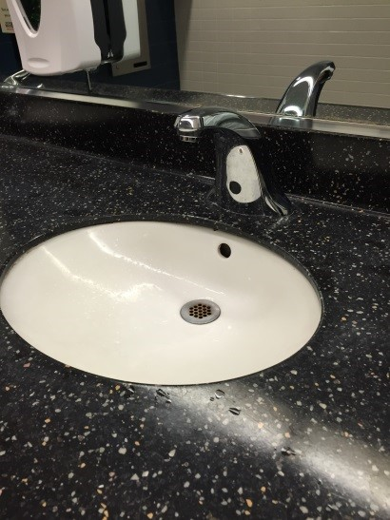
Water
DWR Grant
LID (Low Impact Development) Sites

Slide 7
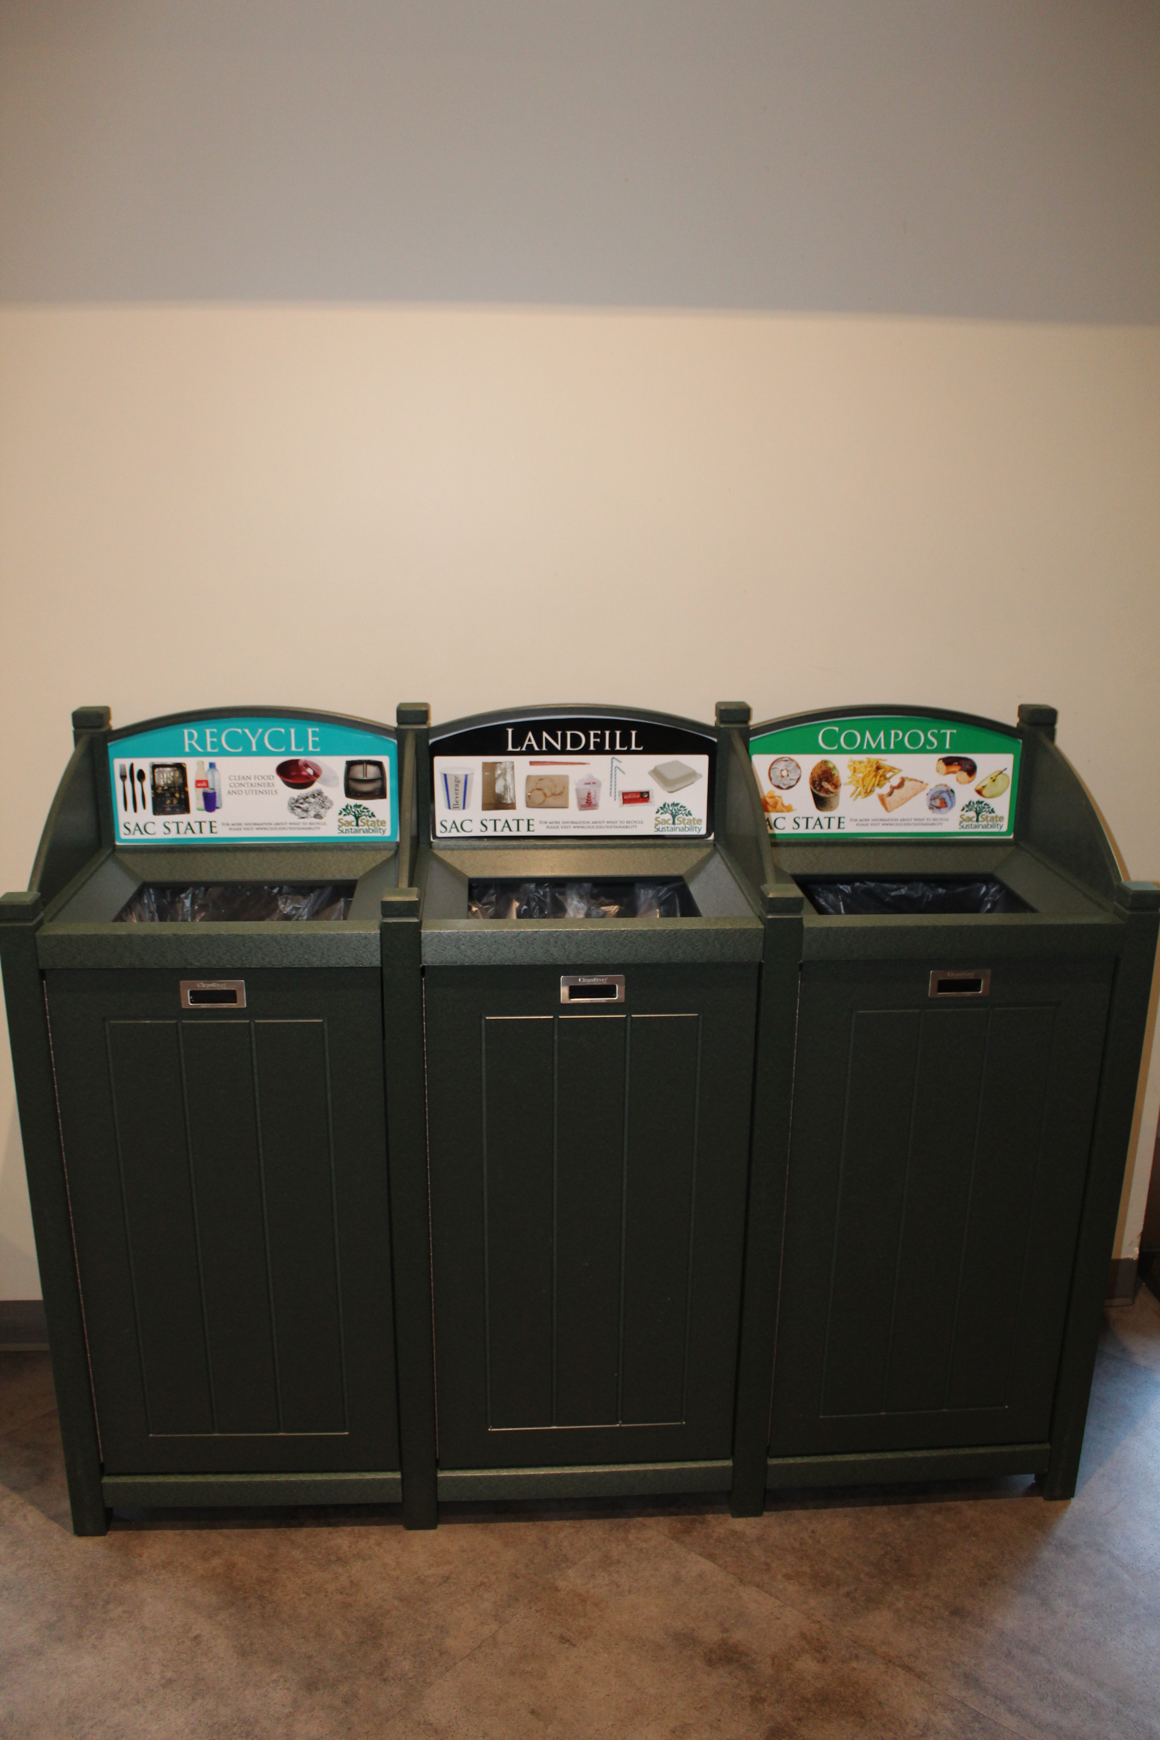
Waste Diversion
Recycling
E-waste
Plastics/glass/aluminum
Composting
BAC Yard
Organic waste pickups from eateries/ coffee shops

Slide 8
Sac State’s Climate Action Plan
Carbon Neutrality Goals & Milestones
Reduce total GHG emissions by 50% by 2030
Reduce total GHG emissions by 80% by 2035
Reduce total GHG emissions to net zero by 2040
Energy
New construction, existing building & infrastructure improvements
Renewable energy
Student, faculty, & staff behavioral changes
Waste
Waste reduction and diversion strategies
Dining
Procurement
Water
New construction
existing building & infrastructure improvements
Transportation
Bicycle circulation
Parking
Commuting reduction

Slide 9
Where We Fit Into the University
Student/community engagement
Tours
Internships
Honey harvests
Campus as a Living Lab (CALL)
Faculty Collaboration
Sustainability Steering Committee
Curriculum enrichment
Campus Infrastructure
Maintenance of current buildings’ energy use
Monitoring data to drive sustainable change

Slide 10
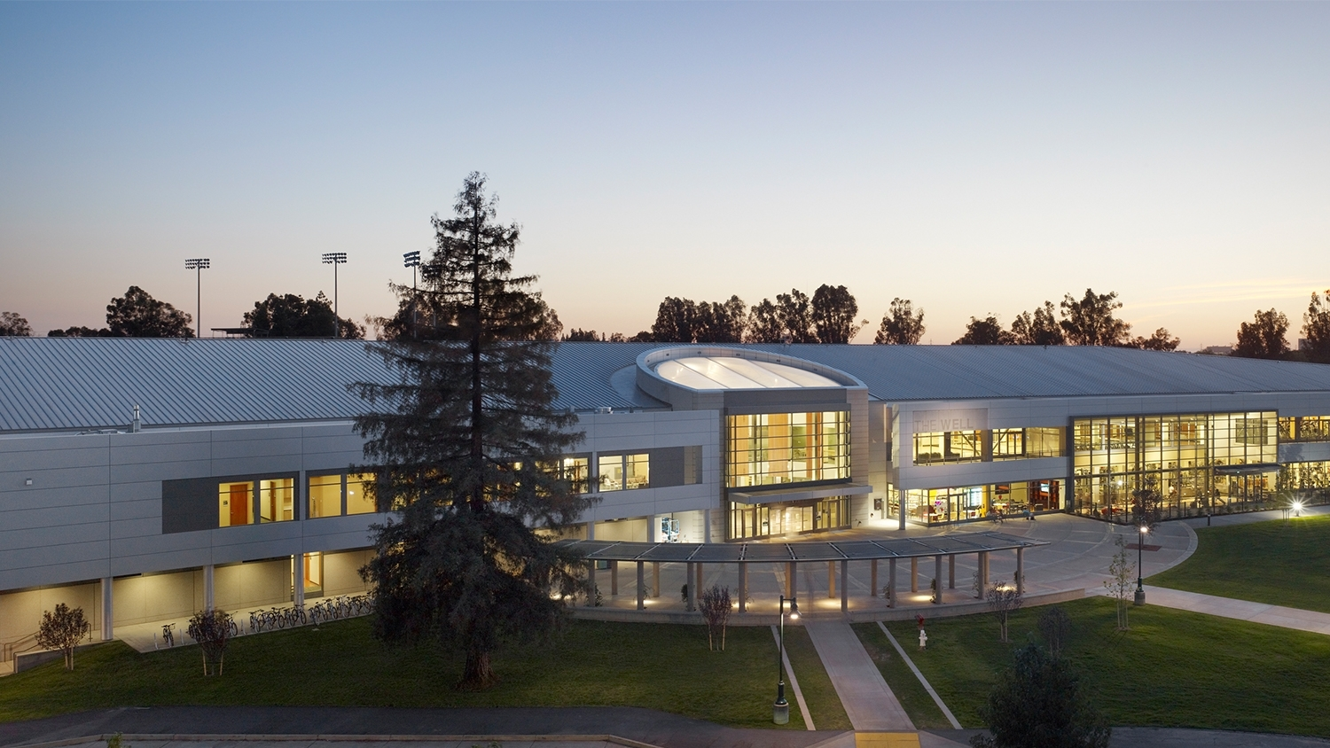
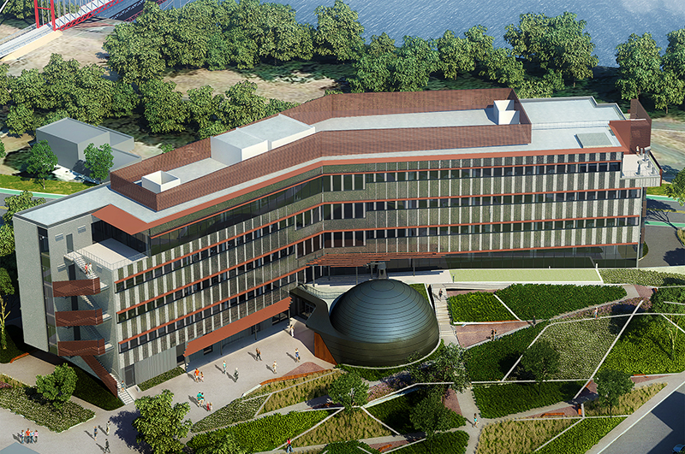
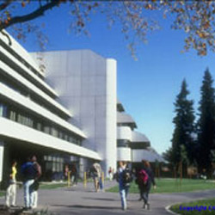
Built Environment
Grid-tied Solar Production
The WELL & the Library
LEED Certified Buildings
The WELL-> LEED Gold
American river Courtyard (Student housing)-> LEED Gold
Ernest E. Tschannen Science Complex (Science Building II)->LEED Gold
Living Building Challenge (LBC)
Arboretum Visitor Center

Slide 11
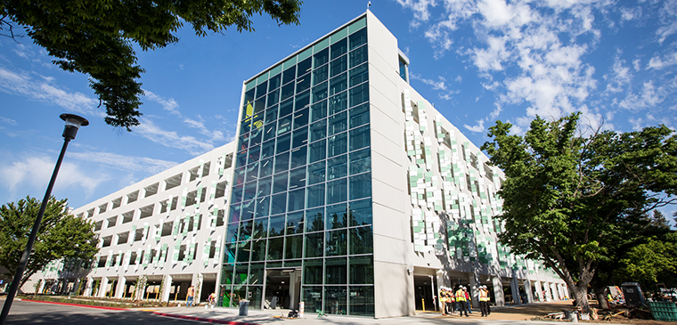
Parking Structure V
Parksmart Certified (USGBC)
Use of precast building elements to reduce traffic impact on campus during construction
Bioswales designed throughout landscaped areas to reduce storm water run off
Installation of a tire filling station to increase car safety and gas mileage
EV charging stations
Carpool and EV/Clean Vehicle designated parking
Installation of parking count system to reduce idle vehicles and assists drivers in finding open spaces through the integrated lighting system
Painted white at the interior to increase visibility within the structure
LED lighting throughout, which is tied to a control system which reduces lighting levels when areas are not in use, and sensors do not detect movement.

Slide 12
We NEED you!
This is a collaborative effort!
In unison we stand a chance to make a difference
Not just a department, sustainability is a state of mind

