Slide 1

Public Health Presentation to SEC
October 15, 2018
Olivia Kasirye, MD, MS
County Health Officer

Slide 2
Topics of interest
Public Health issues with the homeless population – Hepatitis A outbreak
Opioid coalition
Environmental Justice
Lead in drinking water – testing in schools

Slide 3
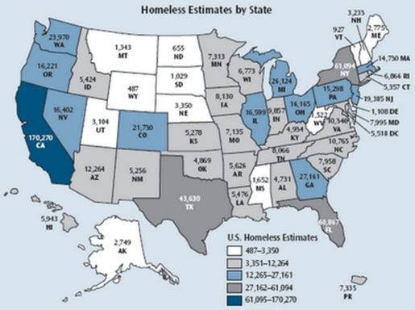
Homelessness in the United States, 2017
U.S. cities that receive federal homelessness assistance grants must do a “point-in-time” count of homeless people the last Wednesday of each January; the homeless are classified as:
  Sheltered: residing in an emergency shelter or in transitional or supportive housing
  Unsheltered: residing in a place not meant for human habitation
U.S. population >326 million
  Total homeless population was 554,000 in 2017
    193,000 (35%) of these were unsheltered (mostly adults; children are rarely unsheltered)
    The number of homeless increased 1% from 2016 to 2017, but there has been a 14% decrease overall since 2007
    2017 increase driven by increase in California numbers
    https://www.hudexchange.info/resources/documents/2017-AHAR-Part-1.pdf

Slide 4

The 10 U.S. Cities with the Largest Homeless Populations and the Percentages of Unsheltered People, 2017
City Area | Total Homeless | Percentage Unsheltered
1. New York City, NY | 76,501 | 5.1
2. Los Angeles City & County, CA | 55,188 | 74.7
3. Seattle/King County, WA | 11,643 | 47.1
4. San Diego City & County, CA | 9,160 | 61.4
5. District of Columbia | 7,473 | 12.0
6. San Jose/Santa Clara City & County, CA | 7,394 | 73.7
7. San Francisco, CA | 7,499 | 42.0
8. Las Vegas/Clark County, NV | 6,490 | 67.1
9. Boston, MA | 6,135 | 3.0
10. Philadelphia, PA | 5,693 | 16.8

Slide 5

Homelessness in California, 2017
California population >39 million (12% of U.S.)
  Homeless population >134,000 (24% of U.S. total)
    California has the highest rate of unsheltered homeless people in the U.S.; 68% overall
    Number of homeless people increased 15% from 2016 to 2017; 9% increase since 2010
    Increase at least partially attributable to a decrease in affordable housing
Unsheltered persons lack access to sanitary living conditions, and even sheltered persons may be exposed to unsanitary conditions
https://www.hudexchange.info/resource/reportmanagement/published/CoC_PopSub_State_CA_2017.pdf

Slide 6
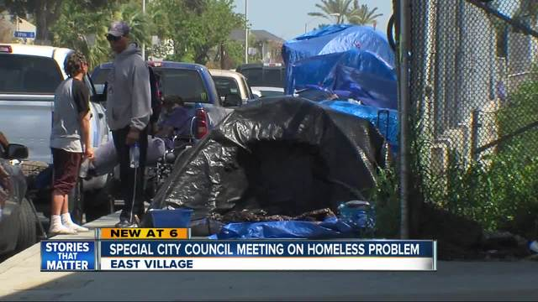
Why Did a Hepatitis A Outbreak Happen in San Diego?
There are many illicit drug users and homeless people; a large percentage of whom are unsheltered and live in unsanitary conditions with no regular access to toilets or water
Bad luck
  It may just be bad luck that hepatitis A entered this population via an infectious person(s) and/or contaminated drugs and the conditions were right for an outbreak to occur, i.e., critical mass + spark
  The risk population in San Diego may have had fewer people who had prior immunity to hepatitis A

Slide 7






How San Diego County Responded to the Increase in Hepatitis A Cases in this Population
Vaccination
Sanitation
Education

Slide 8
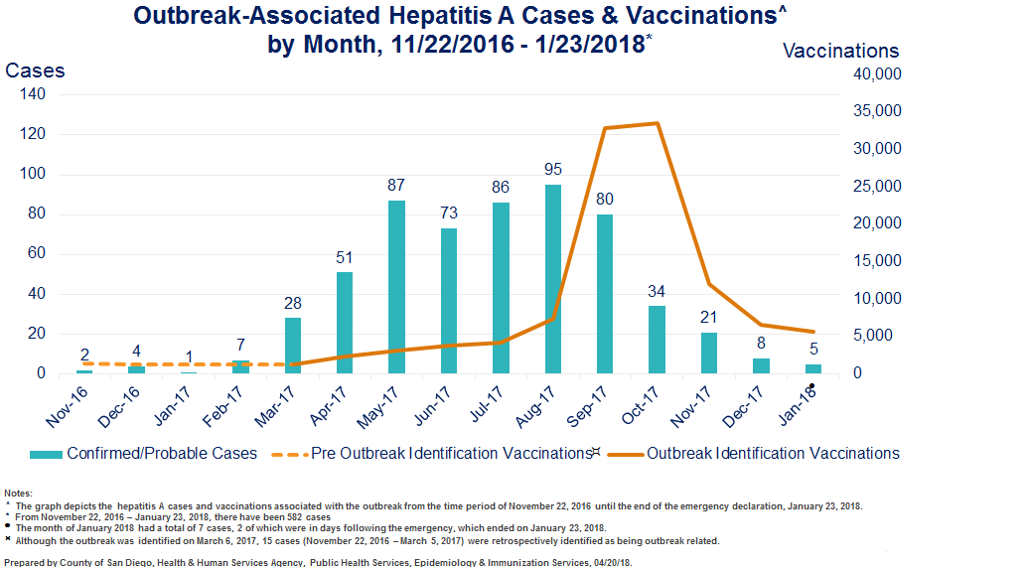
Notes:
This graph shows the results of the vaccination efforts, the blue bars are the number of hepatitis cases per month, while the orange line is the number of adult hepatitis A vaccinations given and entered into the immunization registry. The dashed line is the baseline of around 1,000 per month. The number increased after healthcare provider alert but really increased after the public health emergency was declared in September, and peaked at over 30,000 vaccinations in October.

Slide 9
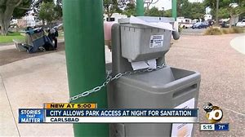
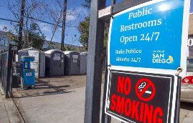
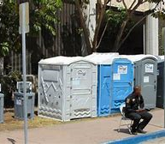
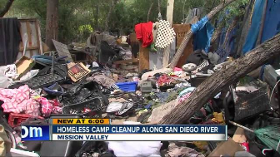
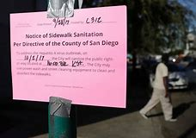
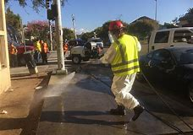

Sanitation
Unsheltered homeless people lack regular access to toilets and running water
Sidewalks and encampments were contaminated with human feces
Access to public toilets was expanded and 160 handwashing stations were installed
Streets and encampments were cleaned

Slide 10
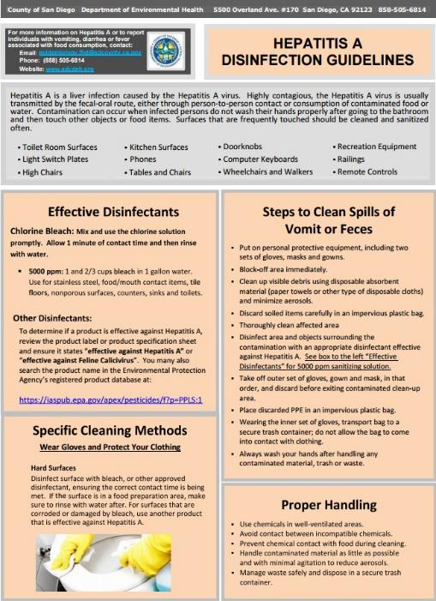
Sanitation
County staff developed and disseminated disinfection guidelines to >10,000 business, government, and other stakeholders to provide information on effective cleaning methods for public areas accessed by the general public and at-risk populations
Available at: https://www.sandiegocounty.gov/content/sdc/hhsa/programs/phs/community_epidemiology/dc/Hepatitis_A.html

Slide 11
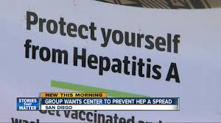
Education
11 health advisories were issued for providers
21 news stories were published
A county outbreak website was created
Educational events were conducted for medical, homeless services and behavioral health providers, businesses, and at-risk groups
Posters were developed for an ad campaign at mass transit and other public locations

Slide 12
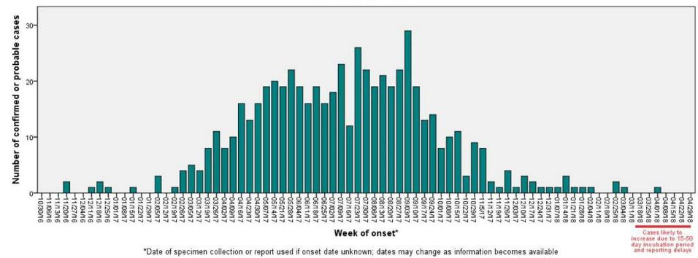
Outbreak-Associated Hepatitis A Cases by Onset Week, San Diego, 11/1/2016 – 5/18/2018*
PHE Declared
CAHAN
PHE Ended
2016 6
2017 570
2018 12
Total 588
Last outbreak-related case: April 4, 2018
PHE = Public Health Emergency
Prepared by County of San Diego, Health & Human Services Agency, Public Health Services, Epidemiology & Immunization Services, 05/18/18

Slide 13

Illicit Drug Use in the United States, 2016
20.1 million Americans were estimated to have a substance use disorder in 2016 (7.5% of people aged 12 or older); of these, 7.4 million were illicit drug users
https://www.samhsa.gov/data/sites/default/files/NSDUH-FFR1-2016/NSDUH-FFR1-2016.pdf
Notes:
Despite stringent drug policies and punitive drug laws, the United States has high levels of illicit drug use. In 2016, over 20 million Americans were estimated to have a substance use disorder.

Slide 14
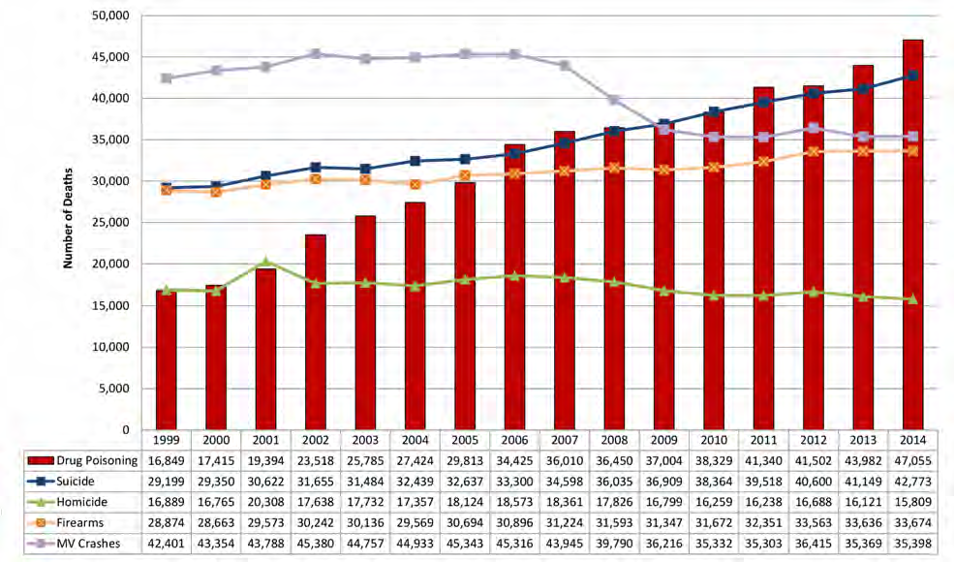
National Injury Death Trends
Notes:
Discuss slide 1 and 2 together, cause and response

Slide 15
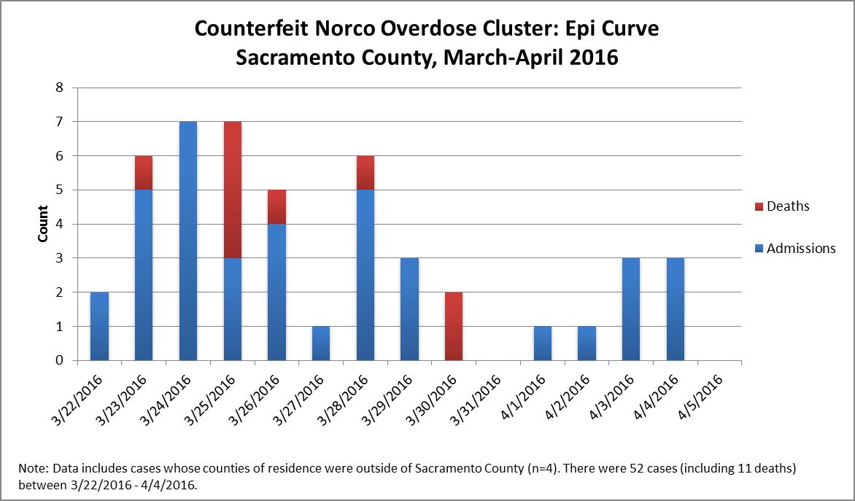
Sacramento County experience
Notes:
Talk about coalition, media out reach: website, facebook and twitter account

Slide 16
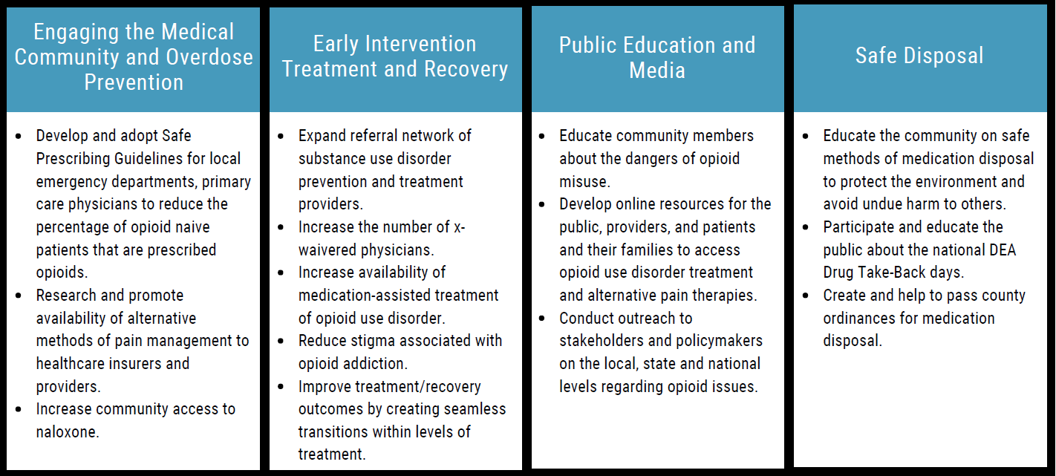
Sacramento County Opioid Coalition
Notes:
Passing of SB 212 that will provide drug disposal mechanism

Slide 17
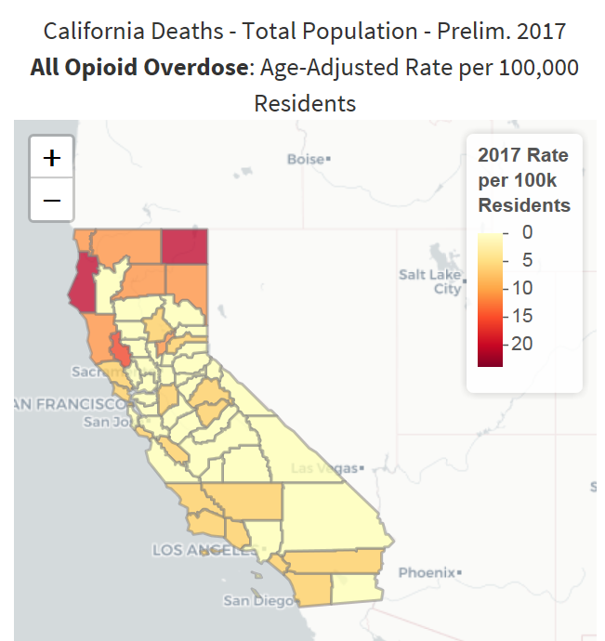
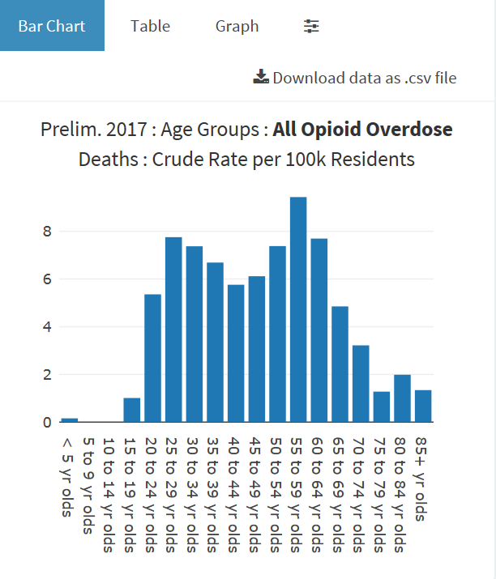
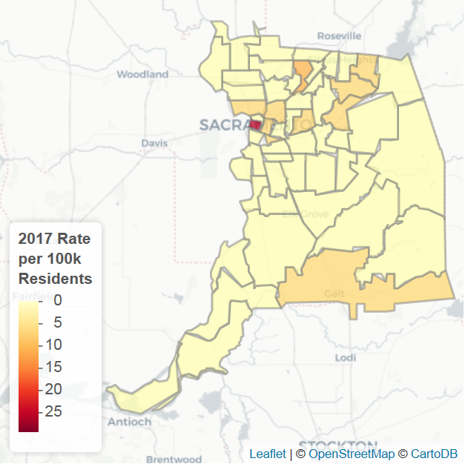
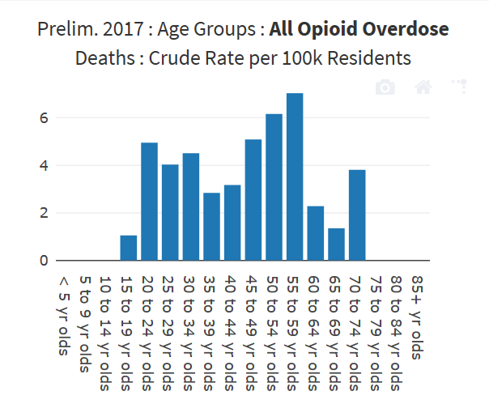
Notes:
From CHDP dashboard on state data – top row
County data – bottom row
Overdose mortality is not the only adverse public health outcome associated with increased OPR use. The rise in opioid consumption has also been associated with a sharp increase in emergency room visits for nonmedical OPR use (69) and in neonatal abstinence syndrome (57).

Slide 18
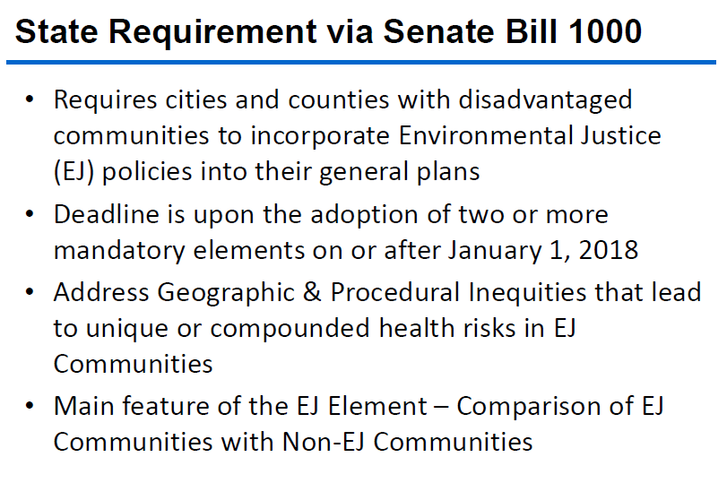
Environmental Justice

Slide 19
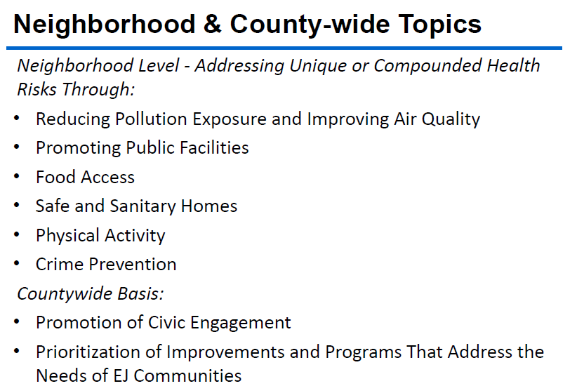

Slide 20
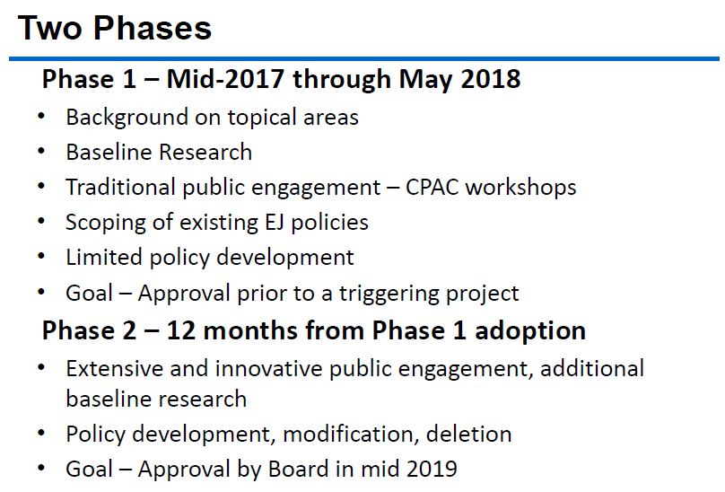

Slide 21
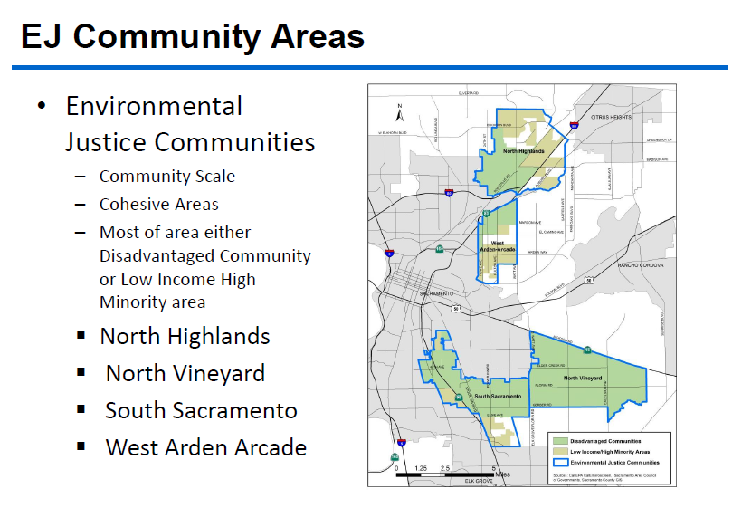

Slide 22
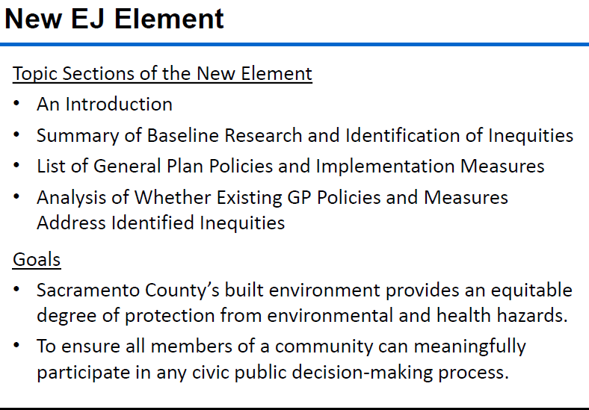

Slide 23
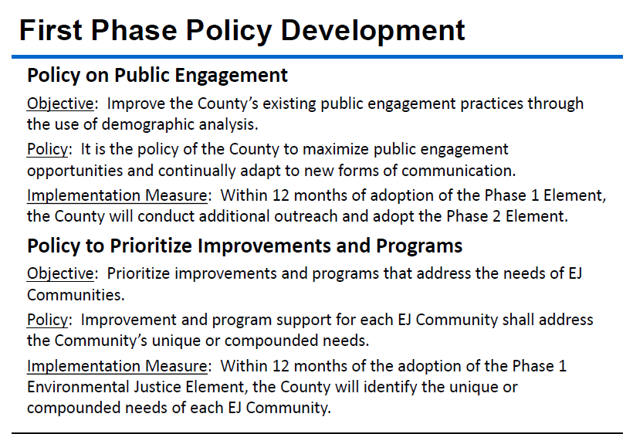

Slide 24
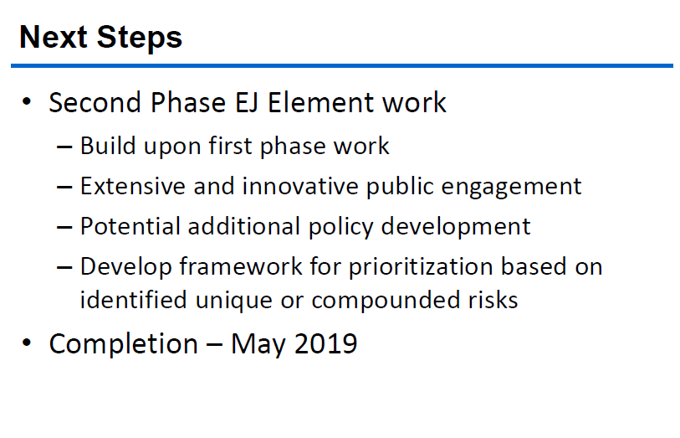

Slide 25


Slide 26
Lead testing in schools
To further safeguard water quality in California’s K-12 public schools, California Assembly Bill 746 published on October 12, 2017, effective January 1, 2018, requires community water system to test lead levels, by July 1, 2019, in drinking water at all California public, K-12 school sites that were constructed before January 1, 2010.

Slide 27
