Slide 1

September 13, 2016
Environmental Management Department
Proposed Five Year Fee Schedule
Marie Woodin, Director
Michael Meyer, Environmental Compliance Division Chief
Kelly McCoy, Environmental Health Division Chief
January 15, 2020

Slide 2
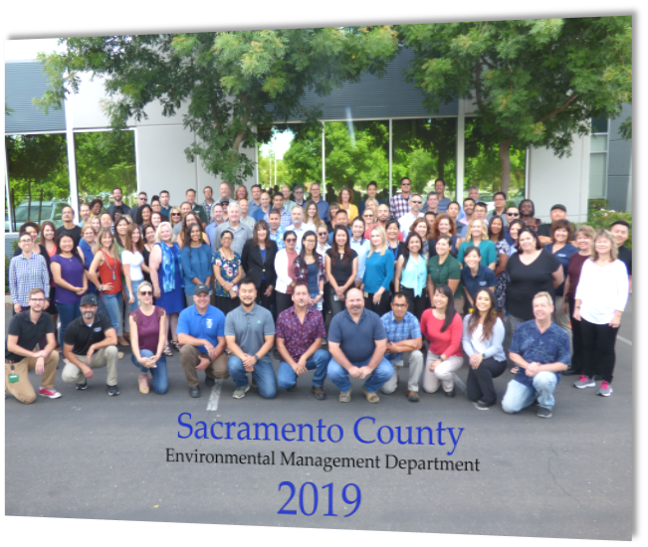
Special Fund Department-100% Fee Supported
Conducted 29,462 Countywide Inspections in FY 2018/2019
124 FTE Specially Trained and Registered Environmental Health Specialists and Support Staff
34 Environmental Programs

Slide 3
Fee Study
Comprehensive Analysis
Facilitated by independent 3rd party-Wohlford Consulting
Time Study
Salaries and Benefits
Services and Supplies
Fee Determination
Service Levels
Supporting Department Services
Minimum Professional Standards
Regulatory Requirements
Multi-level staff involvement

Slide 4
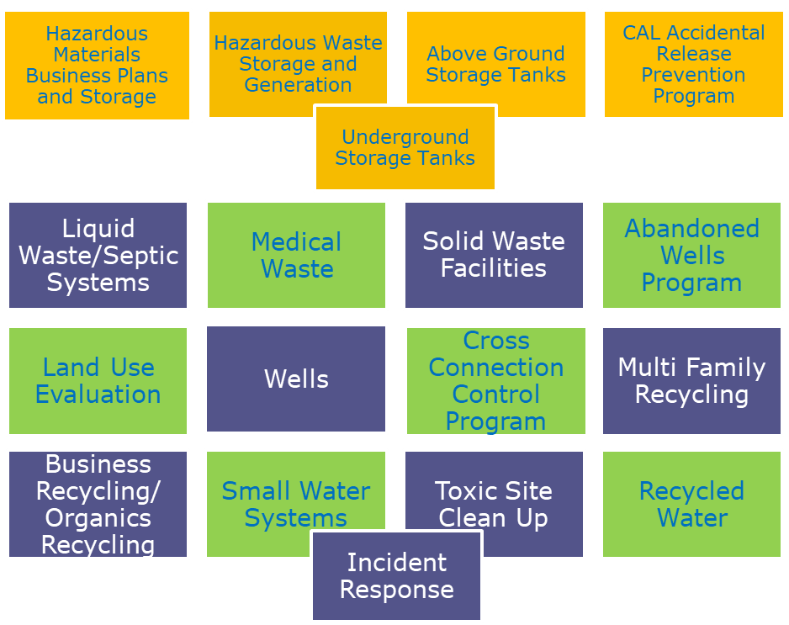

Environmental Management Department
Environmental Compliance
Division
Michael Meyer, Chief
Environmental Compliance

Slide 5
Environmental Management Department
Environmental Health
Division
Food Protection
Cottage Food Program
Tobacco Retailer Program
Construction Plan Review
Noise
Food Safety Education
Recreational Health
Employee Housing
Detention Facilities
Lead Illness
Waste Tire Program
Body Art
Storm Water
Smoking Control
Mobile Food Facilities
Kelly McCoy, Chief
Environmental Health

Slide 6
Food Protection Program
Environmental Management Department
  Permitting and inspection of retail food businesses
  Providing food safety education and training
  Investigation of complaints and suspected cases of foodborne illness

Slide 7
Types of Food Facilities
Environmental Management Department
Restaurants
Convenience Stores
Grocery Stores
Cafeterias
Coffee Shops
Bakeries
Hospitals
Farmers Markets
Mobile Food Facilities
Festivals
Bars
Cottage Food Operations
Commissaries
Produce Stands
Caterers
Swap Meets
  In FY 18/19:
  6,437 Permits issued
  17,211 Routine food inspections
  1,688 Reinspections

Slide 8
Proposed Food Program Fee Schedule
Environmental Management Department
Fee Description | Current Fee | Effective July 1, 2020
Retail Market < 6,000 sq. ft. | $ 619 | $ 519
Restaurant with Bar | $ 1,665 | $ 1,770
Restaurant | $ 1,292 | $ 1,312
Food Preparation | $ 1,014 | $ 1,014
Stormwater - Restaurant | $ 83 | $ 91
Proposed Food Program Fee Schedule with a 3 year phase-in
Fee Description | Current Fee | Effective July 2020 | Effective July 2021 | Effective July 2022
Mobile Food Facility CAT D | $ 670 | $ 732 | $794 | $856

Slide 9
Notes:
Average $1427

Slide 10

Body Art Program
Environmental Management Department
Conducts annual inspections at Body Art Facilities
Maintain registration records for body art practitioners
  Proof of completion of Bloodborne Pathogens training
  Hepatitis B vaccination or declination form
  Plan Review for Body Art Facilities

Slide 11

Inspection
Environmental Management Department
Sanitation/Decontamination
Handwashing/Restrooms
Infection Prevention and Control Plan
Biohazard Management
  In FY 18/19
  177 Body Art Facility inspections
  2 Reinspections
  39 Plan Review inspections
  549 Body Art Practitioner Registered

Slide 12
Proposed Body Art Fee Schedule
Environmental Management Department
Fee Description | Current Fee | Effective July 2020
Body Art Practitioner Registration | $ 181 | $ 181
Body Art Facility Permit | $ 366 | $ 410
Temporary Body Art Practitioner Registration | $ 181 | $ 77
Mechanical Ear Piercing | $ 45 | $ 68

Slide 13
Notes:
Average $487

Slide 14
Certified Unified Program Agency (CUPA)
Environmental Management Department
The Environmental Compliance Division is certified by the California Environmental Protection Agency (Cal-EPA) as the CUPA for Sacramento County.
Hazardous Material Business Plan Program (HMP)
Hazardous Waste Management (HW)
Tiered Permitting
Underground Storage Tanks (UST)
Aboveground Petroleum Storage Act (ASPA)
California Accidental Release Prevention (CalARP)
Notes:
Discuss specialization needed for each program
APSA- All facilities that have ASTs (including 55 gallon drums) with an aggregate storage capacity of ≥1,320 gallons of petroleum are subject to APSA.
CalARP- A CalARP facility is a facility that handles, manufactures, uses, or stores any of the listed regulated substances found in CCR Title 19 tables 1-3 above threshold quantities.
HMBP- If your business handles and/or stores a hazardous material equal to or greater than 55 gallons for liquids, 500 pounds for solids and 200 cubic feet (at standard temperature and pressure) for compressed gases.
Hazwaste- Listed or characteristic
UST- Any tank and its associated piping (located substantially or totally underground) which is used for the storage of hazardous substances.
Tiered Permitting- State of California authorized hazardous waste treatment and storage program that matches each permitted tier with the degree of risk associated with the waste generators treatment or storage activities.

Slide 15
Hazardous Materials Business Plan (HMBP)
Program Description | Current Fee | Effective July 2020 | Effective July 2021 | Effective July 2022 | Effective July 2023 | Effective July 2024
Hazardous Materials Disclosure Fee 1-3 Materials | $552 | $580 | N/A | N/A | N/A | N/A
Hazardous Materials Disclosure Fee, Waste Only | $0 | $79 | $158 | $237 | $316 | $395
Notes:
5203: one year increase only
5214: phased in over five years

Slide 16
Statewide Hazardous Materials Business Plan Fee Comparison
Notes:
Considering:
1-3 Hazardous Materials
Additional Operating Fees *if applicable*
CUPA Surcharge

Slide 17
Underground Storage Tank (UST)
Program Element Description | Current Fee | Effective July 2020 | Effective July 2021 | Effective July 2022
Underground Storage Tank Fee – 1 Tank | $1,103 | $1,193 | $1,283 | $1,373
Underground Storage Tank Fee – 2 Tanks | $1,325 | $1,387 | $1,449 | $1,512
Underground Storage Tank Fee – 3 Tanks | $1,531 | $1,565 | $1,598 | $1,632
Underground Storage Tank Fee – 4 Tanks | $1,729 | $1,750 | $1,772 | $1,793

Slide 18
Statewide UST Fee
Comparison Chart
Notes:
The chart reflects other CUPA Fees in comparison to the One UST Tank program fees established by Sacramento CUPA.
One Tank UST

Slide 19
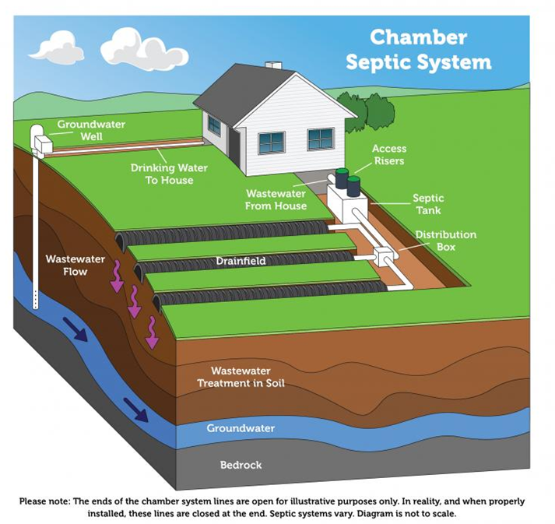
Liquid Waste Program
Environmental Management Department
Where there is no connection to a public sewer system, homeowners and businesses may rely on an onsite wastewater treatment system (OWTS), or septic system, to dispose and treat effluent, or wastewater.

Slide 20
Environmental Management Department
Liquid Waste Permit/Service | Current Fee | Effective July 2020 | Effective July 2021 | Effective July 2022
Standard System Install Permit | $746 | $887 | $1,028 | $1,169
Engineered/Advanced System Install Permit | $1,225 | $1,440 | $1,654 | $1,869
Standard Repair Permit | $586 | $780 | $975 | $1,169
Engineered/Advanced System Repair Permit | $693 | $932 | $1171 | $1,410
Tank Replacement Permit | $426 | $630 | $832 | $1,039
Test Drill | $746 | $895 | $1,045 | $1,194
Engineering Review | $639 | $839 | $1,038 | $1,238
Plot Plan | $107 | $197 | $287 | $377

Slide 21
Environmental Management Department
Liquid Waste Permit/Service | Current Fee | Effective July 2020 | Effective July 2021 | Effective July 2022
OWTS Operating Permit (Annual Reporting) | $320 | $473 | $627 | $780
OWTS Operating Permit (Triennial Reporting) | $107 | $148 | $189 | $230
OWTS Operating Permit (5 year Reporting) | $64 | $85 | $106 | $127
Destruction Permit | $71 | $154 | $237 | $320
Temporary Holding Tank Permit (1 year) | $106 | $260 | $414 | $568
Fixed Holding Tank Permit | $426 | $473 | $520 | $568
Pumper Truck Registration | $396 | $434 | $473 | $511

Slide 22
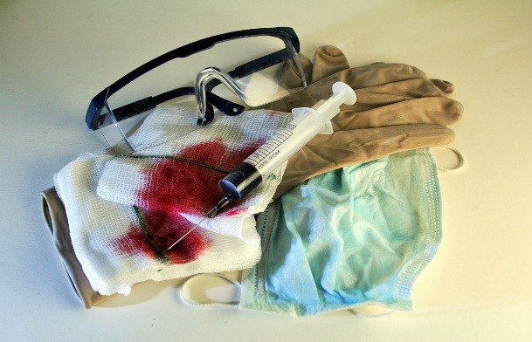


Environmental Management Department
Medical Waste Program
Medical Waste Program is administered on behalf of the Department of the California Department of Public Health, under the Medical Waste Management Act.
EMD ensures that medical waste is
  Properly stored/handled
  Properly disposed

Slide 23
Environmental Management Department
Medical Waste Permit/Service | Current Fee | Proposed Fee
Hospital (1-99 Beds) | $1,231 | $1,455
Hospital (100-199 Beds) | $1,846 | $1,910
Hospital (200-249 Beds) | $2,078 | $2,247
Hospital (250+ Beds) | $2,439 | $2,837
Large Quantity Generator, Onsite Treatment | $318 | $379
Skilled Nursing (1-99 Beds) | $614 | $1,077
Skilled Nursing (100-199 Beds) | New | $1,152
Skilled Nursing (200+ Beds) | $764 | $1,266

Slide 24
Environmental Management Department
Medical Waste Permit/Service | Current Fee | Proposed Fee
Small Quantity Generator Registration-Valid for 2 Years | $0 | $202
Common Storage (2-15 Generators) | $318 | $658
Common Storage (16-49 Generators) | $530 | $769
Common Storage (50+ Generators) | $614 | $1,076
Specialty Clinics | $764 | $836
Primary Care | $764 | $1077
Clinical Labs | $764 | $836
Surgical Clinics | $764 | $836

Slide 25
Environmental Management Department
Medical Waste Permit/Service | Current Fee | Proposed Fee
Mortuaries | $764 | $836
Psychiatric Hospitals | $764 | $836
Veterinarians | $764 | $836
Dialysis Clinics | $764 | $836
Temporary Events | $107 | $126

Slide 26

Land Use Program
Environmental Management Department
Environmental Management Department (EMD) reviews proposed land use entitlements, examples:
  Subdivision Maps
  Parcel Maps
  Conditional Use Permits
  Large Scale Design Review
  Accessory Dwelling Units

Slide 27
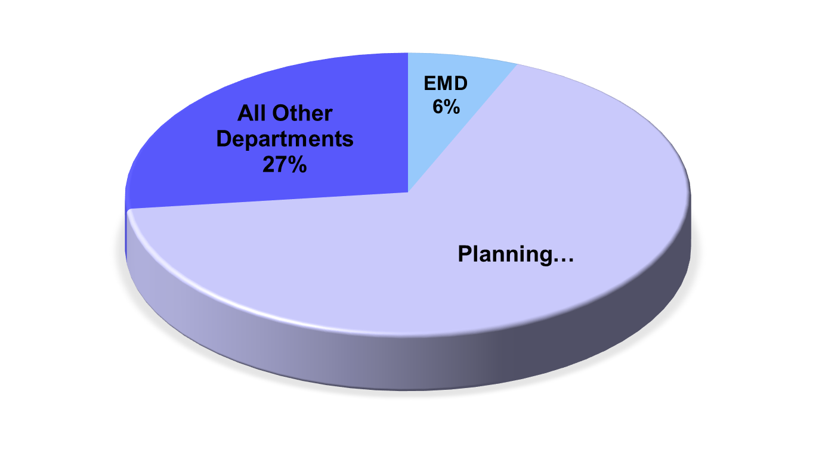
OVERALL PROJECT SERVICE FEE BREAKDOWN
Environmental Management Department

Slide 28
Land Use Permit/Service | Current Fee | Effective July 2020 | Effective July 2021 | Effective July 2022 | Effective July 2023 | Effective July 2024
Subdivision Tentative Map (Any) | $373 | $433 | $492 | $552 | $611 | $671
Subdivision Vesting Map (Any) | $373 | $405 | $437 | $468 | $500 | $532
Subdivision Time Extension - PRJ | $106 | $146 | $185 | $225 | $264 | $304
Subdivision Time Extension - BS | $106 | $144 | $183 | $221 | $260 | $298
Vesting Map Extension | $106 | $145 | $183 | $222 | $261 | $299
Parcel Map - BS | $319 | $389 | $460 | $530 | $600 | $671
Parcel Map - PRJ | $319 | $389 | $460 | $530 | $600 | $671
Parcel Map - SRC | $319 | $389 | $460 | $530 | $600 | $671
Boundary Line Adjustment - Staff Level | $106 | $199 | $292 | $384 | $477 | $570
Notes:
5203: one year increase only
5214: phased in over five years

Slide 29
Land Use Permit/Service | Current Fee | Effective July 2020 | Effective July 2021 | Effective July 2022 | Effective July 2023 | Effective July 2024
Boundary Line Adjustment - SRC | $266 | $327 | $388 | $449 | $510 | $572
Parcel Map Extension – SRC | $106 | $144 | $183 | $221 | $260 | $298
Parcel Map Extension – BS | $106 | $144 | $183 | $221 | $260 | $298
SRC and PRC Meeting Prep | $0 | hourly | hourly | hourly | hourly | hourly
Temporary Mobile Home | $160 | $189 | $217 | $246 | $275 | $304
Use Permit - PRJ | $266 | $322 | $378 | $433 | $489 | $545
Use Permit - BS | $266 | $322 | $378 | $433 | $489 | $545
Use Permit - ZA | $266 | $322 | $378 | $433 | $489 | $545
Notes:
5203: one year increase only
5214: phased in over five years

Slide 30
Land Use Permit/Service | Current Fee | Effective July 2020 | Effective July 2021 | Effective July 2022 | Effective July 2023 | Effective July 2024
Rezone | $106 | $146 | $185 | $225 | $264 | $304
Variance - ZA | $53 | $156 | $260 | $363 | $467 | $570
Variance - BS | $53 | $157 | $260 | $364 | $468 | $572
Environmental Impact Review | $1,136 | $1,247 | $1,357 | $1,468 | $1,579 | $1,689
Environmental Impact Statement | $1,136 | $1,247 | $1,358 | $1,469 | $1,579 | $1,690
General Plan Amendment | $213 | $231 | $250 | $268 | $287 | $305
Community Plan Amendment | $213 | $284 | $356 | $427 | $499 | $570
Community Plan Amendment and Rezone | $213 | $270 | $326 | $383 | $439 | $496
Notes:
5203: one year increase only
5214: phased in over five years

Slide 31
Land Use Permit/Service | Current Fee | Effective July 2020 | Effective July 2021 | Effective July 2022 | Effective July 2023 | Effective July 2024
Development Plan Review - Project | $106 | $182 | $259 | $335 | $411 | $487
Development Plan Review -BS | $106 | $184 | $262 | $340 | $418 | $496
Development Plan Review - Planning | $106 | $219 | $332 | $445 | $558 | $671
Development Plan Review - Single Family | $106 | $219 | $332 | $445 | $558 | $671
Planning / Building / Code Electronic Holds Review and Release (e.g., contaminated sites) - NEW FEE | $213 | hourly | hourly | hourly | hourly | hourly
Notes:
5203: one year increase only
5214: phased in over five years

Slide 32
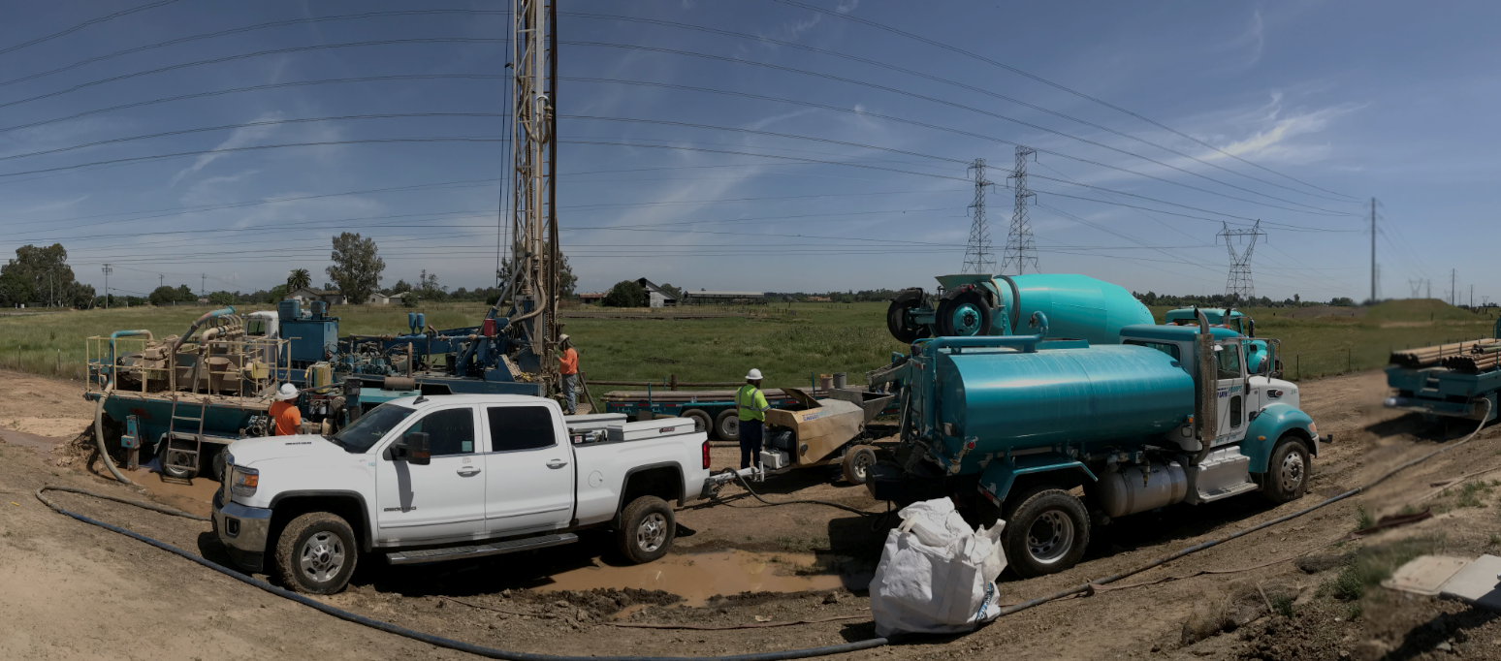
Well Program
Environmental Management Department
Environmental Management Department (EMD) manages the Well Program for Sacramento County
Sacramento County Code, Chapter 6.28
California Water Code, Section 13801
EMD Permits and Inspects:
  Well Construction
  Well Modification
  Well Repair
  Well Inactivation
  Well Destruction

Slide 33
Environmental Management Department
Wells Permit/Service | Current Fee | Effective July 2020 | Effective July 2021 | Effective July 2022
Cathodic Protection, Geothermal Heat Exchange | $426 | $803 | $1,179 | $1,556
Well w/ Pump Installation (Water Well Construction) | $852 | $1,086 | $1,320 | $1,554
Vault Box Repair | $426 | $552 | $678 | $805
Vault Box ELD Wells | $426 | $532 | $638 | $744
Supply Well Destruction | $746 | $948 | $1,151 | $1,353
Monitoring Wells-Construction | $746 | $841 | $935 | $1,030
Wells-Construction (each additional) | $746 | $746 | $746 | $746

Slide 34
Environmental Management Department
Wells Permit/Service | Current Fee | Effective July 2020 | Effective July 2021 | Effective July 2022
Monitoring Well Destruction | $426 | $657 | $889 | $1,120
Monitoring Well Destruction (each additional) | $426 | $523 | $619 | $716
Soil Boring (2 Borings) | $426 | $614 | $803 | $991
Soil Boring (each additional 1-3) | $426 | $483 | $541 | $598
Pump Installation, Replacement, Repair | $107 | $142 | $178 | $213
Well Repair, Deepening, Recasing | $320 | $440 | $559 | $679
Renewal of Abandoned Well Inactivation Permit | $75 | $126 | $177 | $228
Abandoned Well Inactivation | $426 | $497 | $568 | $639

Slide 35
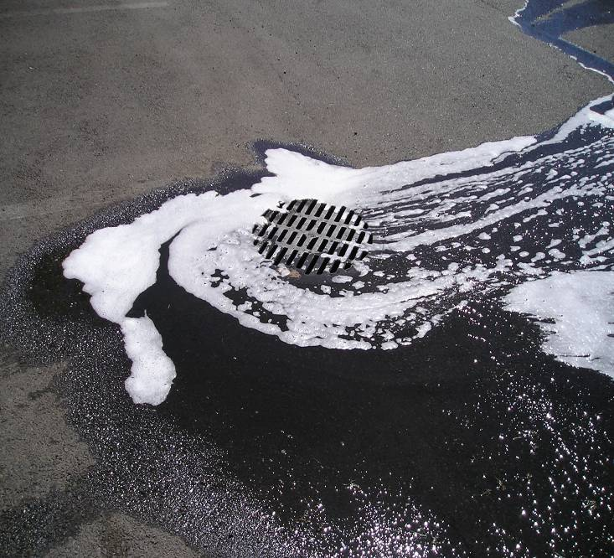
Environmental Management Department
Stormwater Program
EMD provides regulatory oversight in the management of commercial/industrial stormwater discharges including:
Preventing the discharge of pollutants into the storm drainage systems
Elimination/reduction of outdoor pollutant sources that could wash into the storm drain system when it rains
Eliminate illicit connections to the storm drainage systems
Triennial inspections of commercial/industrial facilities to ensure compliance with stormwater discharge requirements

Slide 36
Facilities inspected for Stormwater Compliance
Environmental Management Department
Auto repair shops
Auto body shops
Auto sales, lease and rental facilities
Gas stations
Restaurants
Nurseries
Kennels
Equipment rental businesses
Facilities that have coverage under the State's General Industrial Stormwater Permit
  5,062 Stormwater Permits
  In FY 18/19
  1,890 Routine stormwater inspections
  25 Reinspections

Slide 37
Stormwater
Program Element Description | Current Fee | Effective July 2020
Auto Body Shops | $166 | $150
Auto Repair Shops | $166 | $150
Restaurants | $83 | $91
Retail Gas Outlets | $72 | $65
General Permit Under 10 Acres | $238 | $215

Slide 38




Questions
Environmental Management Department
916-875-8550
www.emd.saccounty.net
EMD-FeeOutreach@SacCounty.Net

