Slide 1


FY 2026 - FY 2027 Body Art Program
Fee Proposal Outreach
Environmental Management Department

Slide 2

Smoking Control
September 13, 2016
Environmental Management Department
Food Protection
Mobile Food Facilities
Cottage Food Program
Food Safety Education
Recreational Health
Tobacco Retailer Program
Construction Plan Review
Noise
Employee Housing
Detention Facilities
Lead Illness
Waste Tire Program
Body Art
Storm Water
Medical Waste
Environmental Health Division

Slide 3
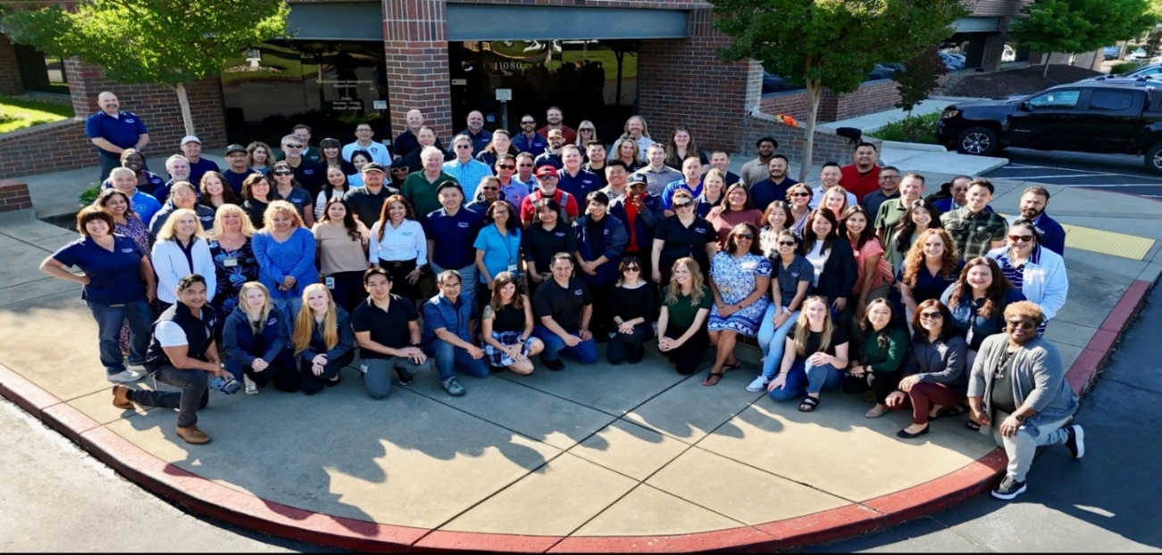
Special Fund Department- 100% Fee Supported - $21 Million Budget
Conducted 27,000 Countywide Inspections in FY 2025
114 FTE Specially Trained, Registered Environmental Health Specialists and Support Staff
31 Programs
Environmental Management Department
Who Are We?

Slide 4

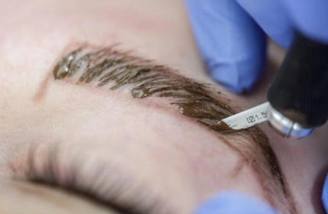

The Safe Body Art Act was passed in 2012 and is intended to protect both the body art practitioner and the client from the transmission of infectious diseases through minimum statewide standards for persons who perform tattooing, body piercing, branding, and the application of permanent cosmetics.
Environmental Management Department
Background

Slide 5
Background
Environmental Management Department
Body Art Program
Conducts annual inspections at Body Art Facilities
Ensures that tattoo artists are registered
Maintains registration records for body art practitioners
  Proof of completion of Bloodborne Pathogens training
  Hepatitis B vaccination or declination form
  Plan Review for Body Art Facilities

Slide 6
Inspections
Environmental Management Department
Sanitation/Decontamination
Handwashing/Restrooms
Infection Prevention and Control Plan
Biohazard Management
In FY 24/25
Routine inspections: 174
Re-inspections: 1
Practitioner Registered: 438
Temporary Practitioner: 70
Body Art Event Permits: 11
Plans Reviewed: 30

Slide 7
Body Art Program Cost Recovery
Environmental Management Department
Do Not Receive General Fund
SCC 6.99.170 Allows for full cost recovery for the administering the program:
  Permit
  Licensing
  Registration
  Inspection
Health and Safety Code, Chapter 7, Section 119324.5 Allows for full cost recovery for administering the program:
  Issuing license and permits
  Inspections, investigations, audits, enforcing orders, and administrative enforcement
Dedicated Environmental Specialist
Body Art Inspection must be conducted by a Registered Environmental Health Specialist and must maintain their registration through the State of California

Slide 8
Program Enhancements
Environmental Management Department
Dedicated staff to assist with documentation
Comprehensive program reviews
Online payments
Use of technology
Use of GIS for resource deployment
Emailing of reports
Home to field inspections to reduce office time

Slide 9
Proposed Body Art Fee Schedule
Environmental Management Department
Fee Description | Current Fee | Effective July 1, 2026
Body Art Practitioner Registration | $ 192 | $ 198
Body Art Facility Permit | $ 389 | $ 400
Temporary Body Art Practitioner Registration | $ 192 | $ 105*
Temporary Body Art Facility Permit | $76 | $78
Mechanical Ear Piercing | $ 48 | $ 49
*Adjusted based on fee study result
*Fees are adjusted based on US Western Consumer Price Index which is at 2.9%

Slide 10

Visit our website at EMD.saccounty.gov
Environmental Management Department
Questions?
Erica Uriarte, Environmental Health Supervisor
Mark Barcellos, Environmental Health Deputy Division Chief

