Slide 1
The Cannabis Industry and the Fire Code

Slide 2
Objectives
Define the Fire Code and discuss application
Identify Fire Code related issues with cannabis cultivation
Identify Fire Code related issues with cannabis manufacturing and laboratory facilities
Identify Fire Code related issues with cannabis extraction
Volatile vs. Non-Volatile

Slide 3
What is the Fire Code?
The Fire Code is a maintenance code
Title 24, Part 9 of the California Code of Regulations
The Fire Code regulates processes:
Use, storage and handling of hazardous materials; flammable finish operations; plant extraction; CO2 enrichment etc.
The Fire Code allows:
Use of applicable NFPA Standards
Use of third party-engineers

Slide 4
Cultivation Hazards
Electrical
Lighting, cords/wires
Structural
“Rooms” not necessarily built to code
External loads on trusses
Humidifiers, carbon filters, lights
CO2 Enrichment
Hazardous Materials Use, Storage and Handling

Slide 5
CO2 Enrichment
Either bulk CO2 systems with piping and “nozzles” or use of propane/compressed gas burner
Increases plant production
What takes 5 months outdoors can be achieved in 3 months indoors. Overall growth is increased approx. 3 times
Hazards
Carbon Dioxide is odorless, colorless and displaces oxygen
Grow rooms are typically airtight as possible to prevent leakage
OSHA PEL (6/2016) TWA – 5000 PPM (8 Hours)
Rooms are generally maintained between 1200-1500 PPM
CO2 Detection System – 2016 CFC Chapter 53

Slide 6
Sulfur and Cannabis
Common indoor cultivation pests include mites and molds
Used as both a fertilizer and pest control method
Can react with hydroponic chemicals
Hydrogen Sulfide, Carbon Disulfide can be produced under fire conditions
Sulfur is a flammable solid

Slide 7
High Pressure lighting
CO2 Generator
Constructed “ceiling”
Plywood “wall”

Slide 8
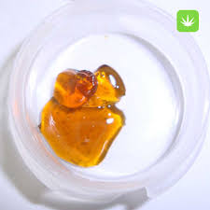
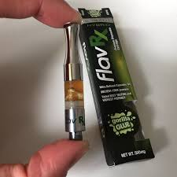
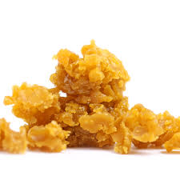
Manufacturing Facilities
Two Classifications
Type 6 – Non-volatile extraction or mechanical extraction
Type 7 – Volatile solvent extraction
Take the oil/wax/shatter and package it for retail distribution
Vape cartridges/pens, measured amounts of wax/shatter
Facilities may have hazardous materials in small amounts (<55 total gallons) for further refinement

Slide 9
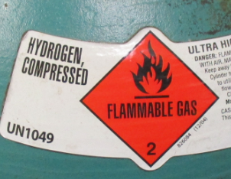
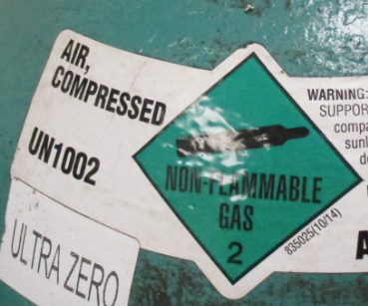
Laboratory Facilities
Use a variety of equipment from GCS and mass-spectrograph
Compressed gases are common
Hydrogen, helium and nitrogen/inert gas
Hydrogen/flammable gas use requires special detection and safety features
Flammable liquids are common (ethanol, methanol etc.)

Slide 11
Extraction Facilities
Two categories:
Volatile – butane, propane and hexane
Non-volatile – CO2 and ethanol
High amounts of hazardous materials
Compressed gases
Flammable solids and liquids

Slide 12
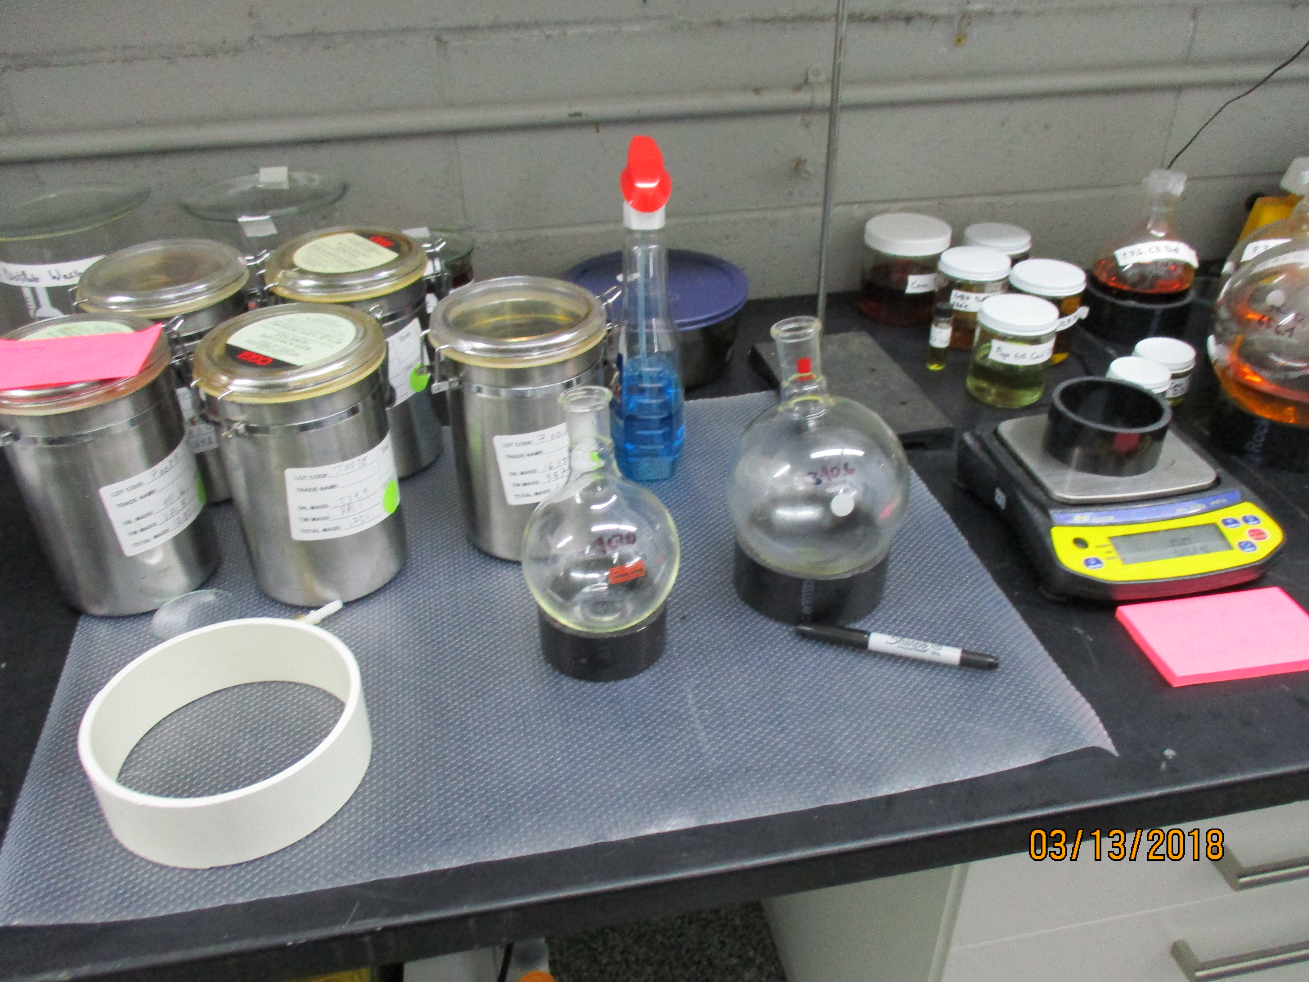

Slide 13
Extraction Equipment
Operates under high pressure
Some as high as 10,000 PSI
Equipment is not listed as a whole
Individual components can be
Require registered design professional evaluation (2016 CFC Chapter 38)

Slide 14
Winterization
Extracted wax is combined with ethanol
Mixture is placed in a freezer
Chilled mixture separates and then ran through rotovap
Ethanol is reclaimed and reused
Separated cannaboids further processed to extract THC, CBD for products

Slide 15
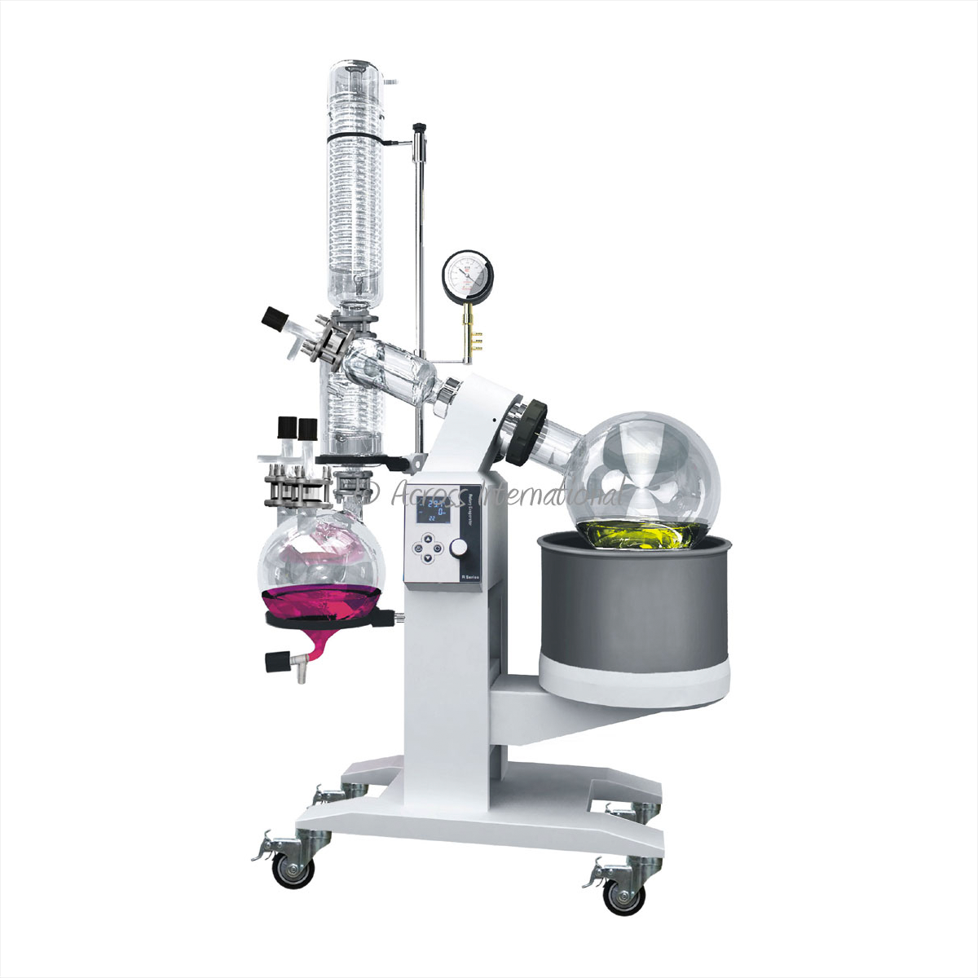

Slide 16
CFC Chapter 38
Requires a Registered Design Professional to review the information provided by manufacturer
Report is required if the material they are extracting is not approved for the equipment
Does NOT require a specific discipline
SFD requires either a ME or FPE
14 points for report

Slide 17
Technical Report
Manufacturer information
Preparer of record on technical report
Date of review and report of revision history
Signature page: A. Author of report; B. Date of report; C. Date and signature of record
Model number or serial number of item
Methodology of the review process
Equipment description – all components
General schematic/process flow
Analysis of the vessels if pressurized beyond standard atmospheric pressure
Structural analysis of frame
Process safety analysis
Comprehensive process hazard analysis
Review of manufacturer’s instructions
List of references used on analysis

Slide 18
Summary
The cannabis industry has it’s own hazards, most stemming from the industry not being regulated.
The hazards of this industry are not really different than any other, just new processes for AHJ’s to learn
Fire, Building Codes and NFPA Standards are addressing the processes

Slide 19
Any questions? Thank you for your attention
FM Jason Lee – jalee@sfd.cityofsacramento.org
Sr. FPO Marty Hill – mhill@sfd.cityofsacramento.org
Sr. FPO Elizabeth McDowell – emcdowell@sfd.cityofsacramento.org
FPO II Ken Kwong – kkwong@sfd.cityofsacramento.org
FPO II Matt Dutcher – mdutcher@sfd.cityofsacramento.org

