Slide 1
Menu Labeling Is Now The Law
Sacramento County
Environmental Management Department
Presented by Elena Drobenyuk, REHS

Slide 2
Covered Establishments
Restaurants or similar retail food establishments (SRFE) that offer for sale “restaurant type food”
Exempt: Schools, food trucks, sidewalk carts, trains, airplanes, hotels with complimentary breakfast, and in-patient only food service facilities located in hospitals
Part of a chain with 20 or more locations (regardless of the type of ownership)
Doing business under the same name
Offering for sale substantially the same menu items

Slide 3
What Does the Law Require?
Disclose calorie information on menus and menu boards for standard menu items
Disclose calorie information on signs adjacent to foods on display and self-service foods that are standard menu items
Post a succinct statement concerning suggested daily caloric intake “2,000 calories a day is used for general nutrition advice, but calories needs vary”
Post statement that written nutrition information is available upon request “Additional nutritional information available upon request”
Provide written nutrition information for standard menu items upon consumer request

Slide 4
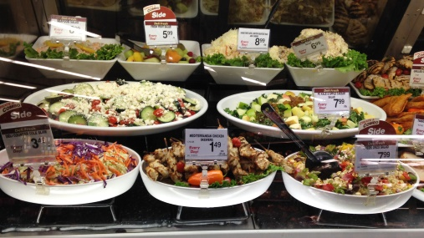
Restaurant Type Foods
Foods usually eaten on the premises, while walking away, or soon after arriving at another location and either served in the establishment or processed and prepared primarily in the establishment
Not Restaurant Type Foods:
Bulk foods (e.g., dried fruit, nuts)
Foods eaten over several eating occasions or stored for later use (e.g., loaves of bread, bags or boxes of dinner rolls, whole cakes, and bags or boxes of candy or cookies)
Foods that are usually further prepared before consuming (e.g., deli meats and cheeses)
Foods that are not self-service and not intended solely for an individual consumption (e.g., deli salads, items sold by weight)

Slide 5
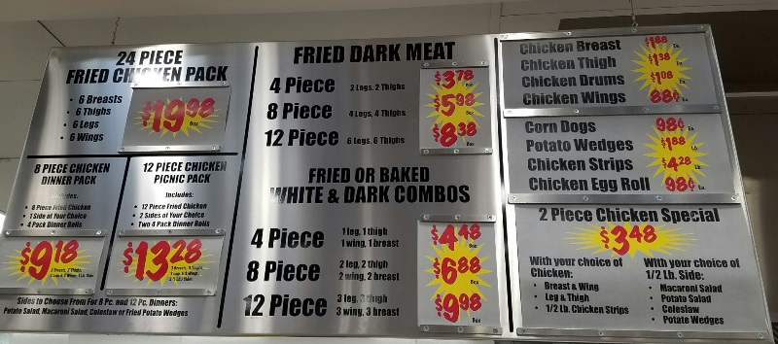
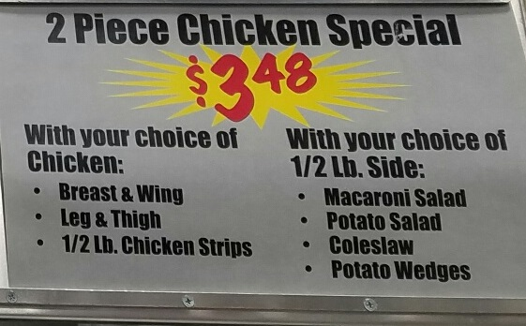
Calorie Declarations for Deli Salads
Exempt deli salads were added to a menu board and now are considered “restaurant type food”
Display calories on a menu board and on display

Slide 6
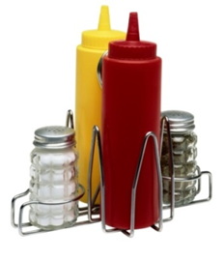
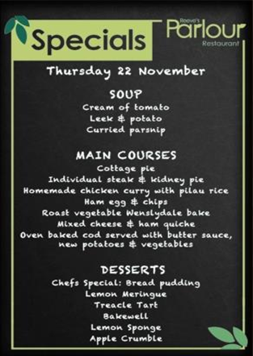
Foods that are Exempt
Custom orders, which are prepared in a specific manner at the customer’s request
Daily specials, foods that are not routinely listed on the menu and are promoted as a special menu item for that day
Temporary menu items, which appear on a menu or menu board for less than a total of 60 days per calendar year
Condiments available for general use, including those placed on the table or on or behind the counter (e.g., flasks of pancake syrup on the table)
Customary market test items, that are offered for fewer than 90 consecutive days to test consumer acceptance
Foods that are not on a menu or menu board and are not on display or self-service (these foods are not considered “standard menu items”)

Slide 7
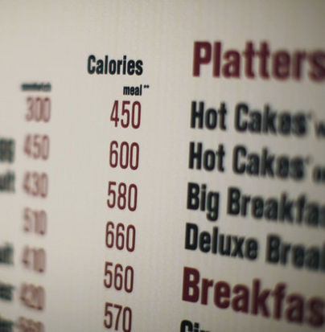
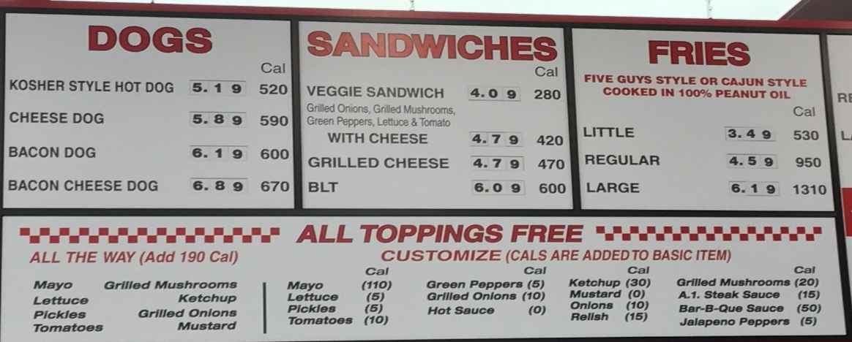
Displaying Calories
Calories for each standard menu item listed on a menu or menu board must be displayed adjacent to the name or price of the menu item
In a type size no smaller than that of the name or price of the menu item, whichever is smaller
In the same color or in a color “at least as conspicuous” as that used for the calorie declarations
If a column format is used, the term “Calories”
or “Cal” must appear at the top of the column
Notes:
(5-calorie increment – 50 calories & 10-calorie increment > 50 calories)

Slide 8
Displaying Calories
For menu items that come in different flavors or varieties that are listed as a single item, calorie declarations must be presented:
With a slash when there are only two options (e.g., “120/240 calories”)
As a range if there are three or more options (e.g., “120-400 calories”)
These top bullets do not apply, when a customer combines standard menu items for a specific price and the calories for each standard menu item are already listed
(e.g., ‘‘Combine Any Sandwich with Any Soup or Any Salad for $8.99’’)

Slide 9
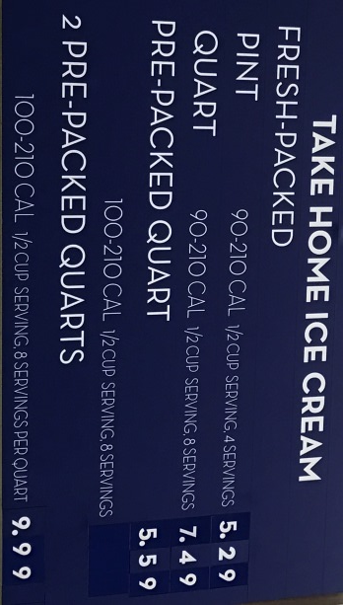
Displaying Calories
The number of calories contained in each standard menu item listed, as usually prepared and offered for sale
In the case of multiple-serving, the calories declared must be:
For the whole menu item listed, as usually prepared and offered for sale (e.g. “pizza pie: 1600 cal”)
Or
Per discrete serving unit as long as the discrete serving unit (e.g., pizza slice) and total number of discrete serving units contained in the menu item are declared (e.g., pizza pie: 200 cal/slice, 8 slices)

Slide 10
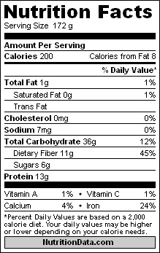
Self-Serve Foods and Food on Display
Must have a sign(s) near the food with the number of calories per serving or per item
“550 calories per pastry”
“180 calories per scoop of pasta salad”
“120 calories per 12 fluid ounces (small)”
The final rule provides 3 options for calorie declarations:
On a sign adjacent to and clearly associated with the corresponding food
Including calories directly on the package of “grab and go” items
On a sign attached to the sneeze guard
On a single sign or placard listing the calorie declaration for several food items (as long as it’s located where the consumer can view the information while making their selection)

Slide 11
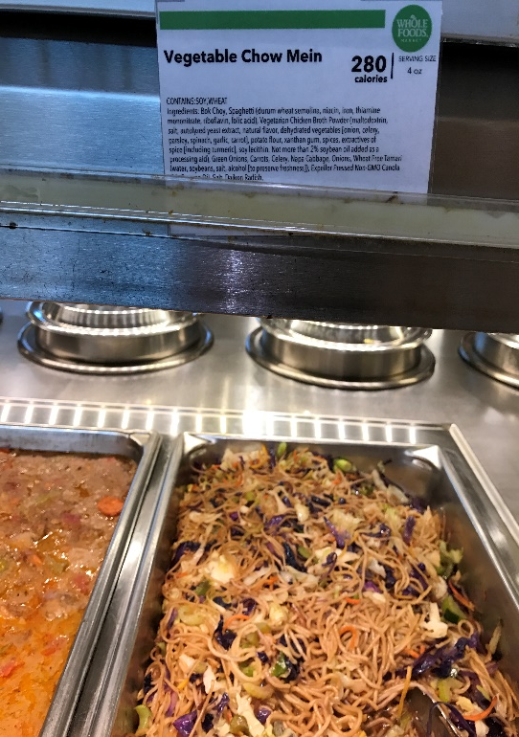
Calorie declaration for All-You-Can-Eat Buffet
The menu board must include a statement, adjacent to the name or price of the item, referring customers to the self-service buffet for calorie information. (e.g., ‘‘See buffet for calorie declarations’’)
Establishment must place a sign adjacent to the food with number of calories per item or serving.

Slide 12
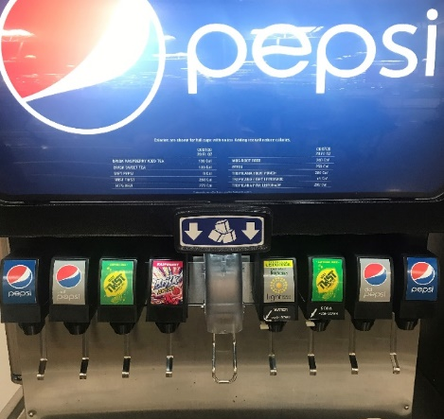
Calorie Declarations for Foods on Display
If foods on display are also listed on the menu or menu board they must
Meet the requirements for declaration of calories on menus and menu boards AND
Meet the requirements for foods on display
Ask yourself, “can the customer view posted calories while making their selection?”

Slide 13
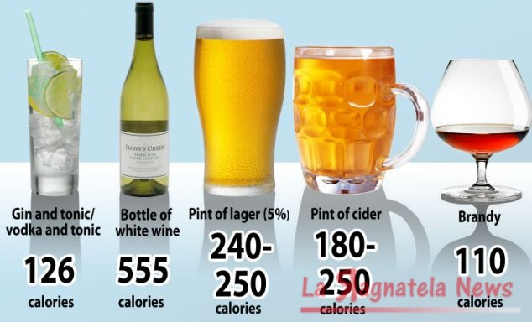
Displaying Calories for Beverages
Must state number of calories in full volume of the cup as served without ice UNLESS facility ordinary dispense and offer for sale a standard beverage fill
Covered establishments must disclose calories and other nutritional information for alcoholic beverages that are on menus and menu boards
Exemption: alcohol that is on display behind the bar & beer on tap (and not on the menu, menu board, or not self-service)

Slide 14
Required Statements
Succinct Statement “2,000 calories a day is used for general nutritional advice, but calorie needs vary”
Optional statements are permitted on children’s menus and menu boards
Must appear on the bottom of each page of a multi-page menu and on the bottom of the menu board
‘‘Additional nutrition information available upon request’’
On menus, statement must be posted on the bottom of the first page along with the Succinct Statement
On menu boards, statement must be posted besides the Succinct Statement
Type size no smaller than smallest type size for any calorie declaration appearing on the same menu or menu board, with certain color and contrast requirements
“1,200 to 1,400 calories a day is used for general nutrition advice for children ages 4 to 8 years, but calorie needs vary.”
“1,200 to 1,400 calories a day is used for general nutrition advice for children ages 4 to 8 years and 1,400 to 2,000 calories a day for children ages 9 to 13 years, but calorie needs vary.”

Slide 17
Written Nutrition Information
Must be available in written form and provided or readily available to the customer upon request
This nutrition information must be presented in the order listed and using the measurements listed
The information must be presented in a clear and conspicuous manner likely to be read and understood by the ordinary individual under customary conditions of purchase and use
*
* The final rule revises the Nutrition Facts label by: removing the declaration of
‘‘Calories from fat’’ (May 27, 2016)
Notes:
Current research shows that the total fat in the diet is less important than the type of fat. In addition, consumer research shows that removal of the declaration of ‘‘calories from fat’’ has no effect on consumers’ ability to judge the healthfulness of a product.
If “Cal from fat” not declared, no violation

Slide 18
Minor Violation

Slide 19
Minor Violation

Slide 20
Minor Violation

Slide 21
Minor Violation
Notes:
Statements must be clear, conspicuously visible to consumer, and posted prominently.

Slide 22
Minor Violation

Slide 23
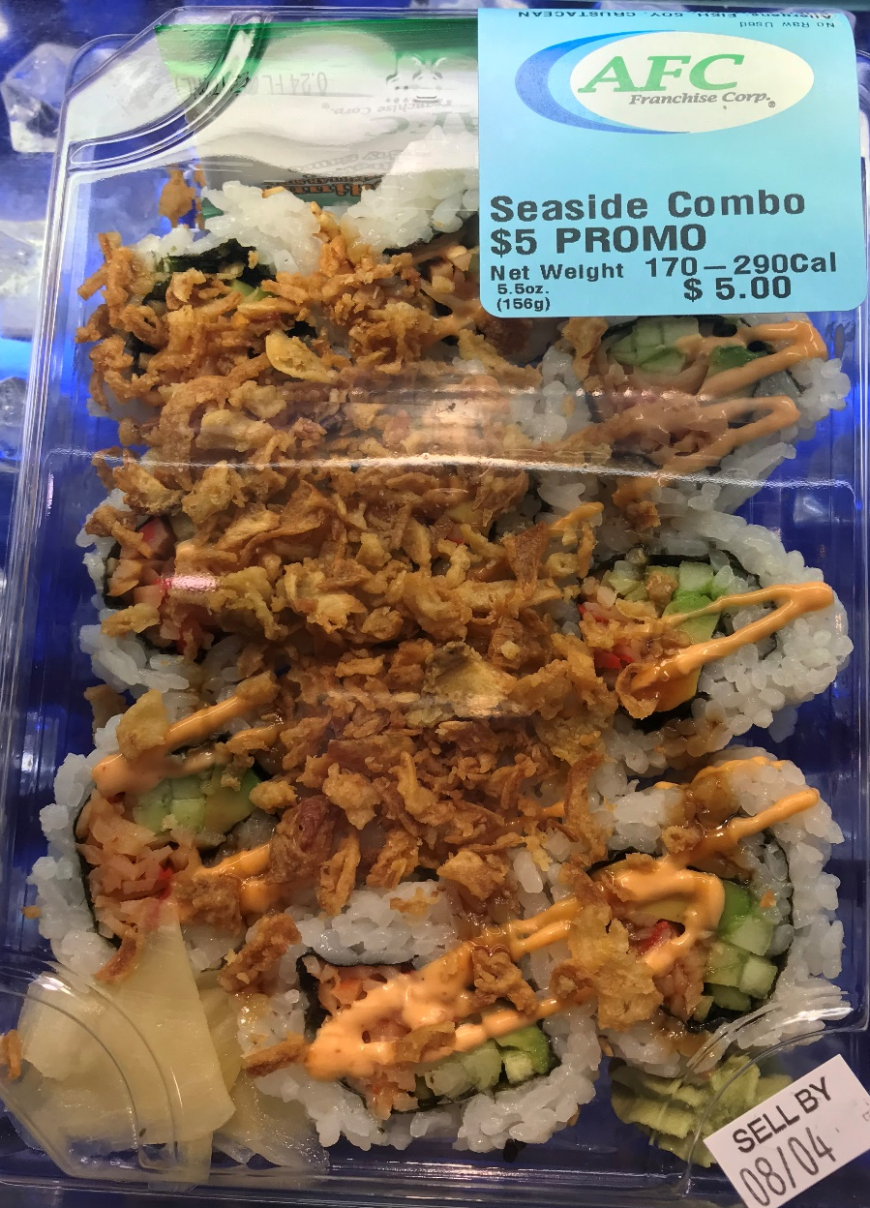
Minor Violation
Notes:
the calorie and other nutrient declarations could be based on the average values obtained when comparing the nutrient values of the food from different suppliers or from the same supplier when variations are known

Slide 24
Minor Violation

Slide 25
Minor Violation

Slide 26
Minor Violation

Slide 27
Minor Violation ?
NO VIOLATION

Slide 28
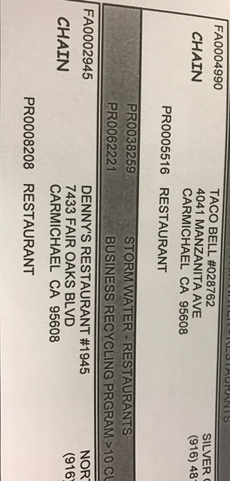
Enforcement
Qualifying facility is listed as “CHAIN” on our inventory, EH5X report
Minor violation #32c
Provide menu labeling CAB and check sheet
Online education module developed by FDA
EMD will verify that the required information is provided per the menu labeling regulation, but will not assess accuracy
Complaints: CalorieLabeling@fda.hhs.gov

Slide 29
Resources
Online education module: https://collaboration.fda.gov/mlm2/ aka https://www.fda.gov/food/food-labeling-nutrition/menu-and-vending-machine-labeling
The final rule is available online at FDA.gov at: https://www.gpo.gov/fdsys/pkg/FR-2014-12-01/pdf/2014-27833.pdf
Issued May 2018 - Guidance for Industry: https://www.fda.gov/downloads/Food/GuidanceRegulation/GuidanceDocumentsRegulatoryInformation/UCM583492.pdf
Issued April 2016 - Guidance for Industry: http://www.fda.gov/downloads/Food/GuidanceRegulation/GuidanceDocumentsRegulatoryInformation/UCM461963.pdf
Issued March 2015 - Compliance Guide: http://www.fda.gov/downloads/Food/GuidanceRegulation/GuidanceDocumentsRegulatoryInformation/UCM437566.pdf

Slide 30
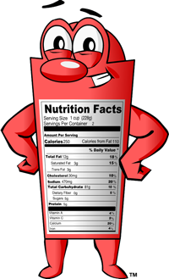
Questions?

