Slide 1
April 2025
Cottage Food Operation Registration (CFO-A) / Permit (CFO-B)
Environmental Management Department

Slide 2
Cottage Food Operation - CFO
Environmental Management Department
The California Homemade Food Act became effective on January 1, 2013.
This law allows certain state approved foods, known as Cottage Foods, to be made in private homes and sold to the public.
Cottage food products are non-potentially hazardous foods that are unlikely to grow harmful bacteria or other toxic microorganisms at room temperature.

Slide 3
Approved Cottage Food Categories
Environmental Management Department
Only foods listed on the CDPH Approved CFO products list may be made with a Cottage Food Permit.
Baked Goods Without Cream, Custard, or Meat Fillings
Ex: Double chocolate chip cookie
Candy and Confections
Ex: Peanut brittle
Extracts Containing at Least 70 Proof or 35% Food-Grade for Human Consumption Ethanol/Alcohol
Ex: Vanilla Extract
Dried, Dehydrated, and Freeze-Dried Foods
Ex: Lemon-pepper dry spice rub
Frostings, Icings, Fondants, and Gum Pastes that Do Not Contain Eggs†, Cream, or Cream Cheese
Ex: Flat icing for sugar cookie

Slide 4
Approved Cottage Food Categories
Environmental Management Department
Honey and Sorghum Syrups
Ex: Raw whipped honey
Fruit Butters, Preserves, Jams, and Jellies that Comply with Part 150 of Title 21 of The Code of Federal Regulations Ex: Strawberry jam
Nuts, Nut Mixes, and Nut Butters
Ex: Roasted peanuts
Powdered Drink Mixes Made from Manufactured Ingredients
Ex: Berry powder drink mix
Vinegars and Mustards
Ex: Plain mustard
Note: Cannabis-infused edibles are not an approved cottage food product.

Slide 5
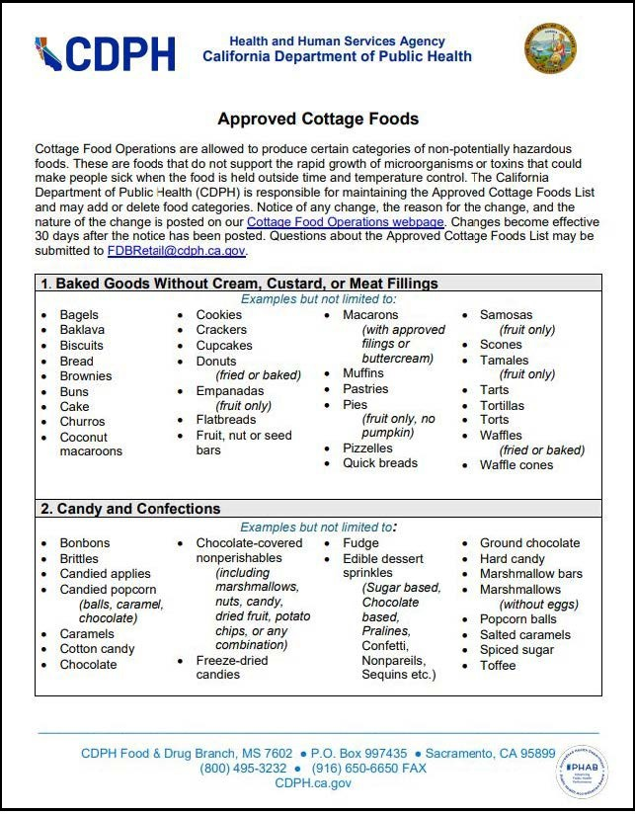
CDPH Approved Cottage Foods List
Environmental Management Department
CDPH Approved CFO products list
Review the list to read about limitations and exceptions for different products.
Note: Add all specific flavors of each product including original/plain

Slide 6
Where to start - Contact EMD
Environmental Management Department
If you are thinking about starting a Cottage Food Operation – Contact EMD!
Specialists are available to answer questions and provide more information.
Call Monday - Friday, 8 AM - 10 AM: (916) 875-8440 email: CottageFood@saccounty.gov
Please note:
Permit or Registration is required prior to operation.
Permit or Registration must be renewed annually through MyHealthDepartment (online application).
Other certificates, licenses, etc. may be required: Zoning, Planning Dept. (County/City), Business Licensing, Business Operations Tax Certificate.

Slide 7
Types of CFO Permit and Registration
Environmental Management Department
Class A Registration “Direct Sales”
Register with EMD through MyHealthDepartment.
No initial or routine inspection.
Inspection(s) may be conducted for a consumer complaint.
Authorized to engage in the direct sales of cottage food products throughout the state of California.
Cottage Food A gross annual sales cannot exceed $75,000*.
*annually adjusted for inflation based on CCPI

Slide 8
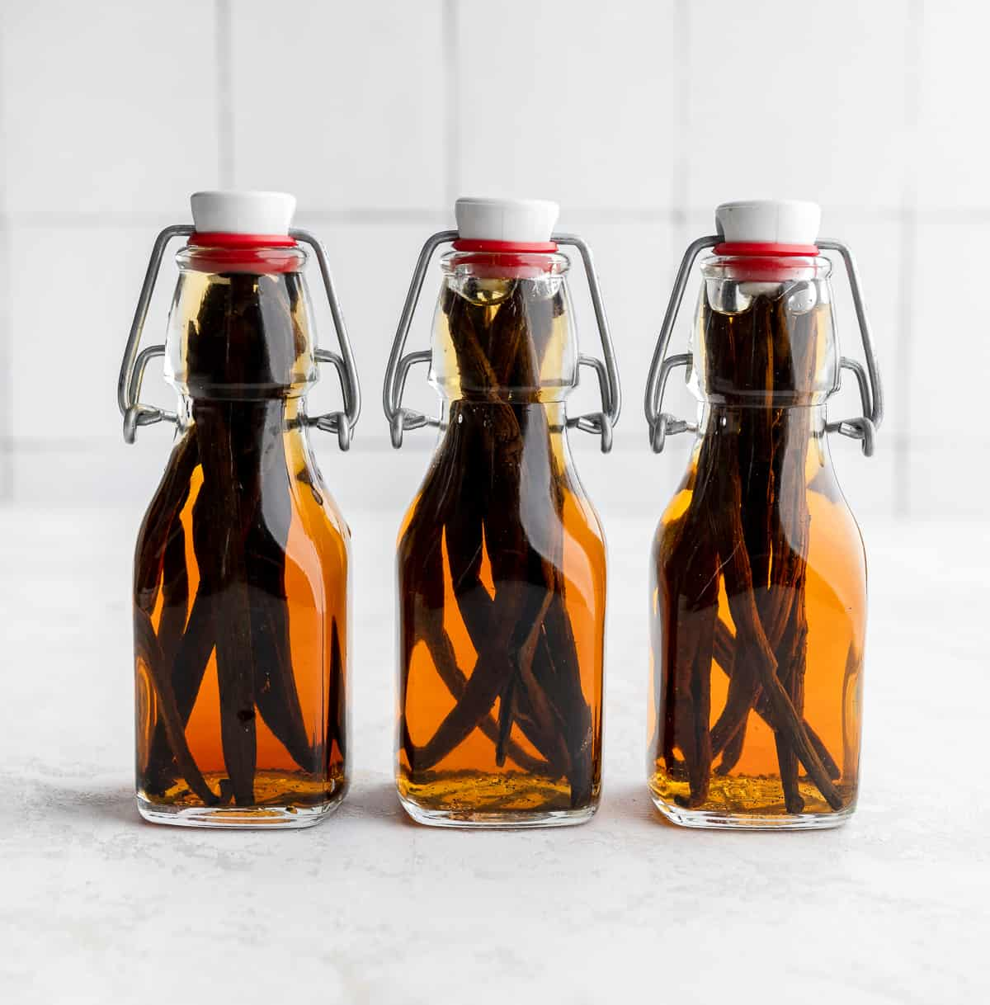
Types of CFO Permit and Registration
Environmental Management Department
Class B Permit “Direct Sales” & “Indirect Sales”
Apply for permit through MyHealthDepartment.
One inspection per year.
Additional inspection(s) may be conducted for consumer complaint.
Authorized to engage in the direct and indirect sales of cottage food products throughout the state of California.
Cottage Food B gross annual sales cannot exceed $150,000*.
*annually adjusted for inflation based on CCPI

Slide 9
CFO A & B - New Applicant Requirements
Environmental Management Department
Submit CFO application with permit/registration payment through MyHealthDepartment.
If the CFO is serviced by a private well, the water shall be tested yearly by an approved laboratory analysis to verify that it meets State water quality standards for bacteriological organisms (E.coli & total coliform) and primary inorganic chemicals (nitrate & nitrite). Approval to operate will be granted after submitting recent (within 3 months) laboratory results.
Food product list.
Sample food label.
Food Handler Card/Food Safety Certification required within 90 days of approval.
Business license required within 90 days of approval.

Slide 10
CFO A & B - Renewal Applicant Requirements
Environmental Management Department
Submit CFO application with permit/registration payment through MyHealthDepartment.
If the CFO is serviced by a private well, the water shall be tested yearly by an approved laboratory analysis to verify that it meets State water quality standards for bacteriological organisms (E.coli & total coliform) and primary inorganic chemicals (nitrate & nitrite). Approval to operate will be granted after submitting recent (within 3 months) laboratory results.
Food product list.
Sample food label.
Food Handler Card/Food Safety Certification required.
Business License from jurisdiction of home residence is required before permit or registration renewal.
10

Slide 11
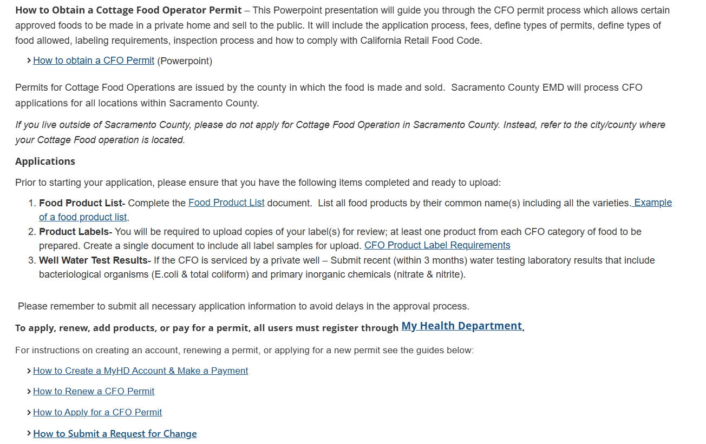
Turning in an Application - MyHealthDepartment (MyHD)
Environmental Management Department
Guidance documents are available on EMD’s website on how to get started.
How to Create a MyHD Account & Make a Payment
How to Apply for a CFO Permit
How to Renew a CFO Permit
How to Submit a Request for Change for a CFO Permit
11

Slide 12
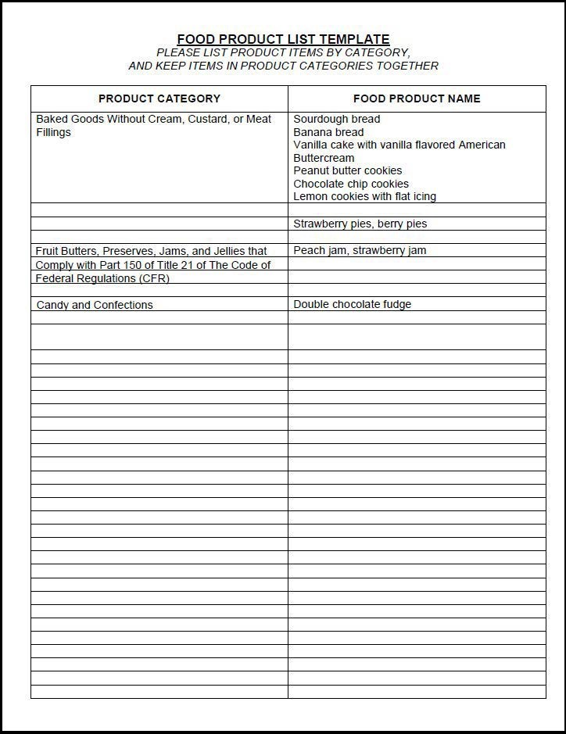
Food Product List
Environmental Management Department
Prior to starting an application, review CDPH’s approved food product list to ensure the product is cottage food approved.
Food Product List Template
Note: Specify all flavors offered including Original/Plain

Slide 13
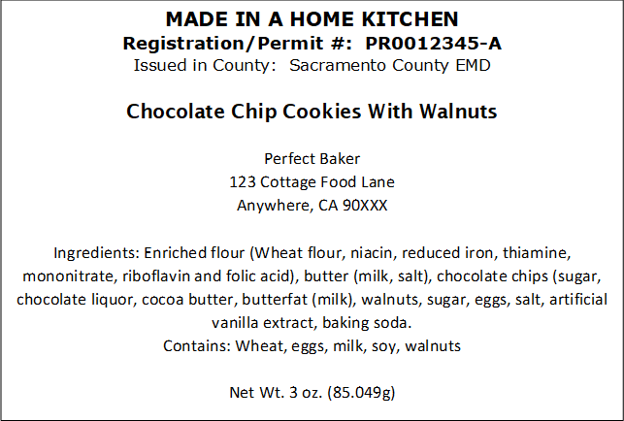
Food Product Label
Environmental Management Department
Cottage food products are required to be labeled in accordance with specific state and federal labeling regulations.
CDPH labeling requirements
Note: Address may be shortened to City, State, and Zip Code

Slide 14
Self-Certification Checklist
Environmental Management Department
Facility Requirements:
The CFO shall be located in a private dwelling where the CFO operator currently resides.
CFO food preparation will take place in the private kitchen within that home.
Additional storage used for the CFO will be within the home and used exclusively for storage.
Sleeping quarters are excluded from areas used for CFO food preparation or storage.
Planning Requirements:
I have complied with the applicable planning requirements for the CFO.
Employee and Training Requirements:
All persons preparing or packaging CFO products shall complete the California Department of Public Health (CDPH) food processor course or California Food Handler Course within 3 months.
The CFO has no more than 1 full time equivalent employee (immediate family or household members are not included).
14

Slide 15
Self-Certification Checklist
Environmental Management Department
Sanitation Requirements:
Kitchen equipment and utensils used to produce CFO products are clean and maintained in a good state of repair.
All food contact surfaces, equipment, and utensils used for the preparation, packaging, or handling of any CFO products shall be washed, rinsed, and sanitized and air dried before each use.
All food preparation and food and equipment storage areas shall be maintained free of rodents and insects.
Food Preparation Requirements (includes packaging and handling):
Warm water, hand soap and single use paper towels are available for hand washing.
Hand washing is required immediately prior to handling foods and after engaging in any activity that contaminates the hands such as after using the toilet, coughing or sneezing, eating or smoking.
All food ingredients used in the CFO products are from an approved source.
Potable water shall be used for hand washing, ware washing and as an ingredient.
15

Slide 16
Self-Certification Checklist
Environmental Management Department
During the Preparation, Packaging or Handling of CFO Product:
Domestic activities such as family meal preparation, dishwashing, clothes washing or ironing, kitchen cleaning or guest entertainment are not allowed.
Infants, small children, or pets are not allowed.
Smoking is not allowed.
Any person with a contagious illness shall refrain from work in the CFO.
Food Processor Course:
Within 3 months of being approved to operate by the Environmental Health Division, please provide proof of completion of the required California Department of Public Health (CDPH) food processor course, or California Food Handler Certificate. The website for CDPH is www.cdph.ca.gov/. You must renew your food handler card every 3 years or food manager's certificate every 5 years.
16

Slide 17
Self-Certification Checklist
Environmental Management Department
Employee:
I understand that I may not have more than one full time equivalent cottage food employee, not including a family member or household member of the cottage food operator, within the registered area of a private home where the cottage food operator resides and where cottage food products are prepared or packaged for direct sale to consumers.
Gross Annual Sales:
I understand that I will lose my CFO status and will need to become permitted in a commercial facility if my CFO business exceeds gross annual sales of $75,000 for CFO A or $150,000 for CFO B per year.
17

Slide 18
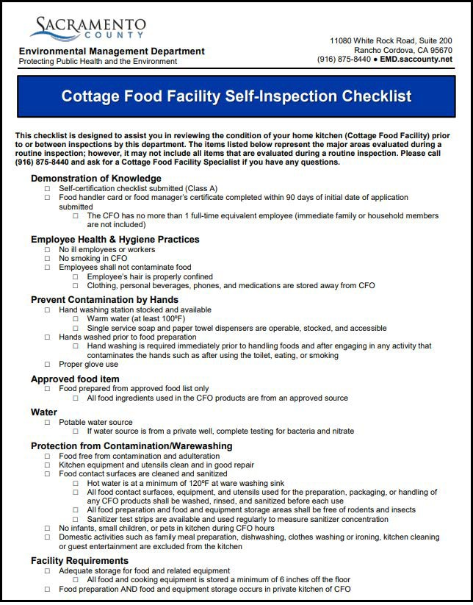
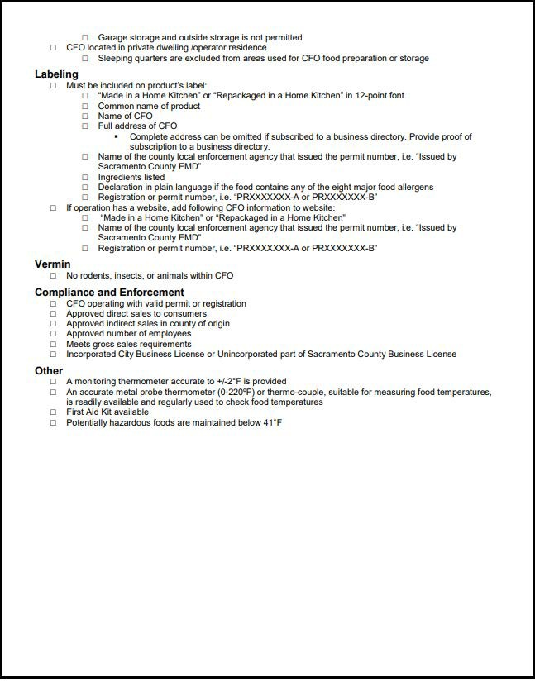
Environmental Management Department
Self-Inspection Checklist
Self Inspection Checklist
18

Slide 19
Environmental Management Department
Questions?
19

Slide 20
Contacts and Additional Resources
Environmental Management Department
Contact EMD:
(916) 875-8440
email: CottageFood@saccounty.gov
EMD's Cottage Food Website:
https://emd.saccounty.gov/EH/FoodProtect-RetailFood/Pages/CottageFood.aspx
Permit/Registration Application:
MyHealthDepartment: https://myhealthdepartment.com/sacramento

