Slide 1

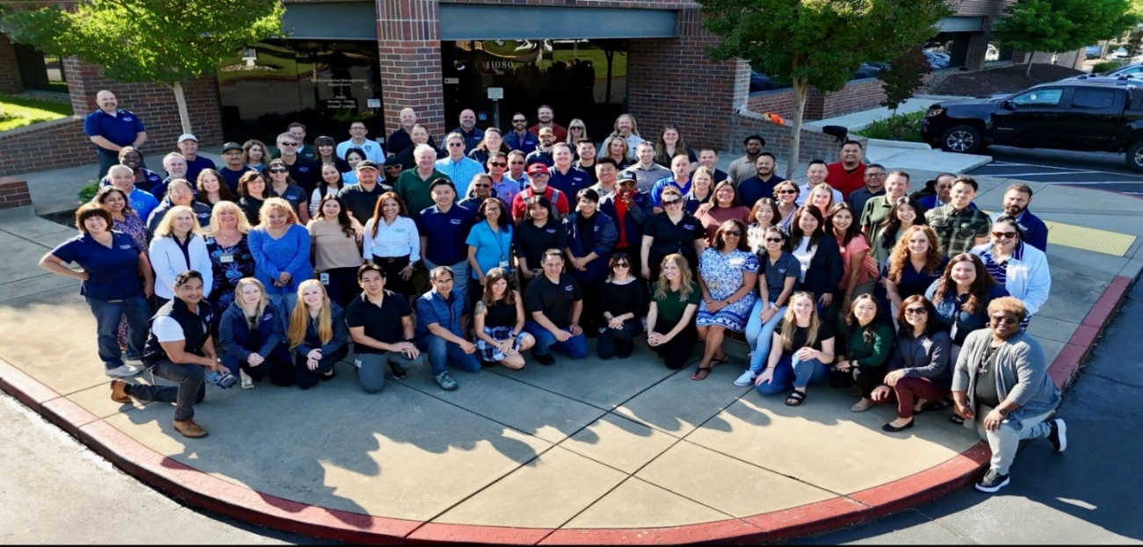
Special Fund Department- 100% Fee Supported - $21 Million Budget
Conducted 27,000 Countywide Inspections in FY 2025
114 FTE Specially Trained, Registered Environmental Health Specialists and Support Staff
31 Programs
Environmental Management Department
Who Are We?

Slide 2
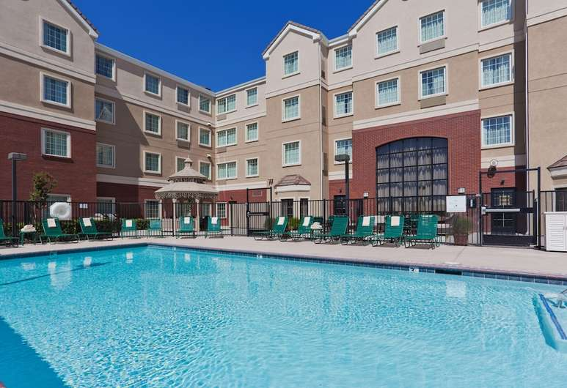
FY 2026 - FY 2027 Recreational Health
Fee Proposal Outreach
Environmental Management Department

Slide 3

Smoking Control
September 13, 2016
Environmental Management Department
Food Protection
Mobile Food Facilities
Cottage Food Program
Food Safety Education
Recreational Health
Tobacco Retailer Program
Construction Plan Review
Noise
Employee Housing
Detention Facilities
Lead Illness
Waste Tire Program
Body Art
Storm Water
Medical Waste
Environmental Health Division

Slide 4
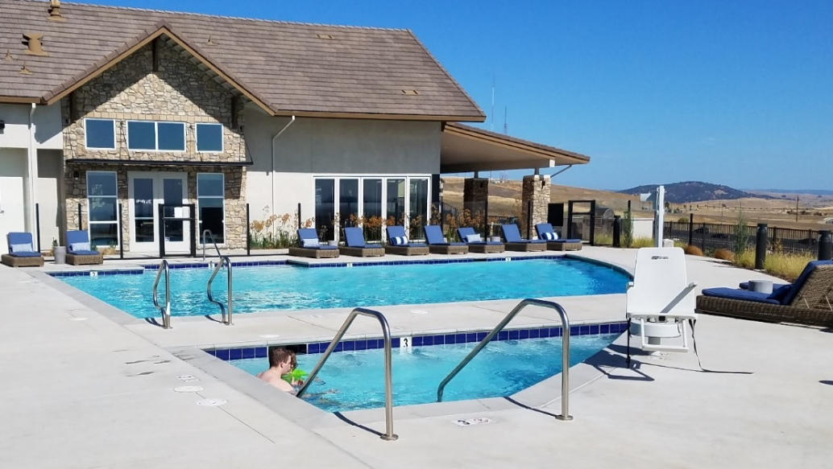
Swimming pools and spas can be sources of diseases such as Giardia, Cryptosporidium, Pseudomonas and Legionella. These are also areas where injuries such as slips, falls, accidental entrapment and drowning can occur, if public pools and spas are not properly maintained and monitored.
Environmental Management Department
Background

Slide 5
Environmental Management Department
Recreational Health Program
The Recreational Health Program has primary responsibility for enforcement of the State laws that apply to “public swimming pools and spas.” The laws governing public swimming pool sanitation and safety are in the following:
The California Health and Safety Code
The California Code of Regulations
The California Building Code
The California Electrical Code
SCC 6.99.310 Public Swimming Pool, Wading Pool, Spa Pool

Slide 6
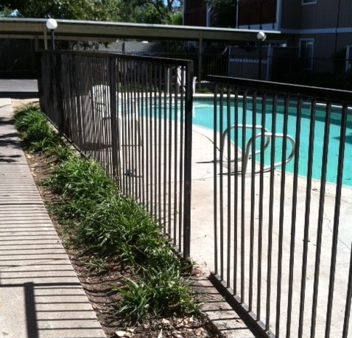
Recreational Health Program
Environmental Management Department
Conducts annual inspections at public pools, spas, spray grounds and water parks throughout Sacramento County (including all incorporated cities) to ensure compliance with state and local health and safety codes.
Respond to complaints of suspected pool related illnesses or unsafe conditions.
In FY 24/25
Routine inspections: 2,230
Re-inspections: 379
Complaints: 135

Slide 7
Recreational Health Cost Recovery
Environmental Management Department
Recreational Health Program is 100% fee supported and does not receive general fund
SCC 6.99.170 Allows for full cost recovery for the administering the program:
Permitting
Inspection
California Code of Regulations, Title 22, Division 4, Environmental Health, Chapter 20 Public Swimming Pools:
Dedicated Environmental Specialist
Public Pool and Spa Inspections must be conducted by a Registered Environmental Health Specialist and must maintain their registration through the State of California

Slide 8
Program Enhancements
Environmental Management Department
Provide Annual Workshops for Pool and Spa Operators, Owners, and HOAs
Added tracking features in the current data management systems to track pool equipment to help pool service companies
Comprehensive program reviews
Online payments
Use GIS for resource deployment
Use of technology
Emailing of reports
Home to field inspections to reduce office time

Slide 9
Proposed Recreational Health Fee Schedule
Environmental Management Department
Fee Description | Current Fee | Effective July 1, 2026
Recreational Health Permit – Pool | $ 700 | $ 720
Recreational Health Permit – Spa | $ 638 | $ 657
Swimming Pool on Single Recirculating System | $ 700 | $ 720
Recreational Health Permit – Wading Pool | $ 494 | $ 508
Spray Grounds | $ 432 | $ 445
Temporarily Inactive Fee | $ 212 | $ 218
*Fees are adjusted based on US Western Consumer Price Index which is at 2.9%

Slide 10

Visit our website at EMD.saccounty.gov
Environmental Management Department
Questions?
Erica Uriarte, Environmental Health Supervisor
Mark Barcellos, Environmental Health Deputy Division Chief

