Slide 1

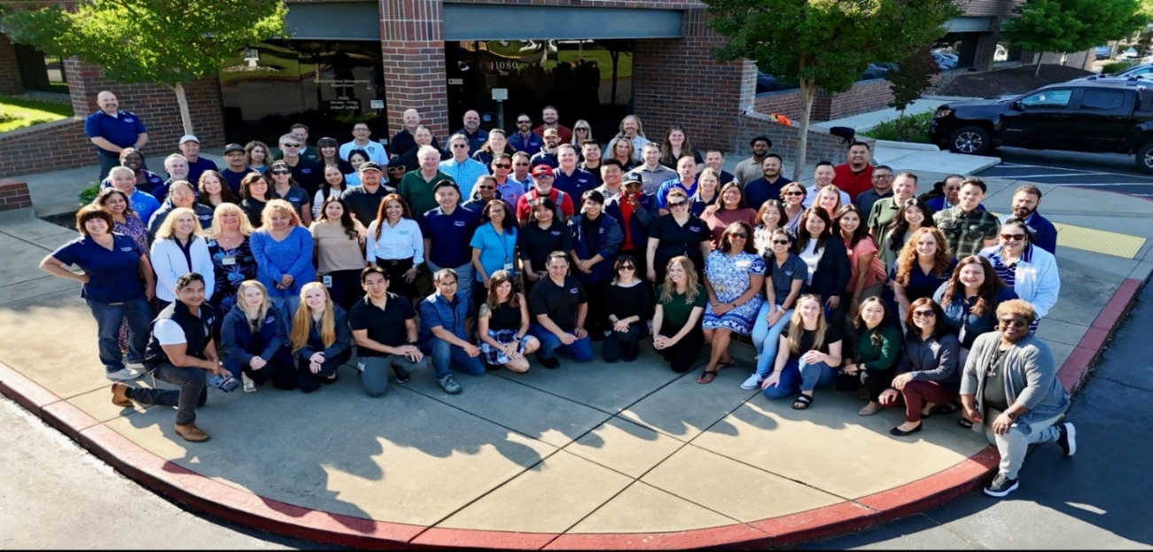
Special Fund Department- 100% Fee Supported - $21 Million Budget
Conducted 27,000 Countywide Inspections in FY 2025
114 FTE Specially Trained, Registered Environmental Health Specialists and Support Staff
31 Programs
Environmental Management Department
Who Are We?

Slide 2
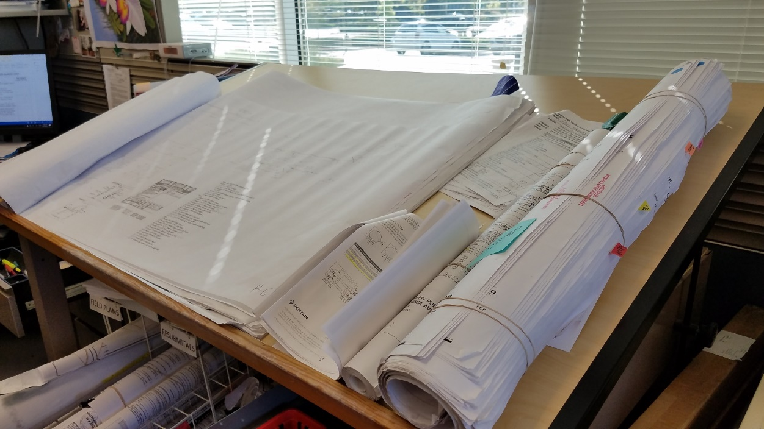
Environmental Management Department
FY 2026 - FY 2027 Plan Review Program
Fee Proposal Outreach

Slide 3

September 13, 2016
Environmental Management Department
Environmental Health Division
Food Protection
Mobile Food Facilities
Cottage Food Program
Food Safety Education
Recreational Health
Tobacco Retailer Program
Construction Plan Review
Noise
Employee Housing
Detention Facilities
Lead Illness
Waste Tire Program
Body Art
Storm Water
Smoking Control
Medical Waste
Environmental Health Division

Slide 4
Environmental Management Department
Plan Review Program
The purpose of the Plan Review program is to ensure that the design and construction of food and recreational health facilities within the Sacramento County meet applicable public health and safety standards
This is accomplished by reviewing and approving construction plans and conducting on-site inspections during the construction process
Plans are required to be submitted and approved for new construction as well as minor and major remodels
In FY 24/25
Food Plans Submitted:
New Construction: 211
Major Remodels: 51
Minor Remodels: 199
Recreational Health Plans Submitted:
New Construction: 17
Major Remodels: 9
Minor Remodels: 467

Slide 5
Food Protection Program
Environmental Management Department
Plan Review Program
Does not receive general fund
Health and Safety Code allows for full cost recovery for implementing and administering the plan review program
SCC 6.99.170 allows for full cost recovery for administering the program
  Reviewing construction plans
  Conducting inspections
Dedicated Plan Review Specialist
Review of food and recreational health construction plans must be conducted by a Registered Environmental Specialist and must maintain their registration through the State of California

Slide 6
Environmental Management Department
Program Enhancements
Electronic Plan Review
On-line Project Status
Plan Review Guide For Food Establishments
Plan Review Submittal Workshops
Cross trained additional staff to conduct final inspections
Efficiencies
Use of technology
Comprehensive Program Reviews to reduce redundancy
Use of GIS to determine current projects in the county
Emailing inspection reports
On-line Service Portals
Home to field inspection – reduced office time

Slide 7
Background
Environmental Management Department
Proposed Plan Review Fee Schedule
Fee Description | Current | Effective July 1, 2026
Retail Market: No Food Prep | $ 1,147 | $ 1,180
Food Facility: New Construction < 2000 sq. ft. | $ 2,489 | $ 2,561
Food Facility: New Construction 2000-6000 sq. ft. | $ 2,857 | $ 2,940
Food Facility: Major Remodel | $ 1,428 | $ 1,469
Food Facility: Minor Remodel with Inspection | $ 953 | $ 981
Recreational Health: New Construction Pool/Spa | $ 2,639 | $ 2,716
Recreational Health: Major Remodel | $ 1,734 | $ 1,784
Recreational Health: Minor Remodel with Inspection | $ 607 | $ 625
Recreational Health: Minor Remodel Without Inspection | $ 203 | $ 340*
*Adjusted based on fee study result
* Fees are adjusted based on US Western Consumer Price Index which is at 2.9%

Slide 8

Visit our website at EMD.saccounty.gov
Environmental Management Department
Questions?
Erica Uriarte, Environmental Health Supervisor
Mark Barcellos, Environmental Health Deputy Division Chief

