Slide 1

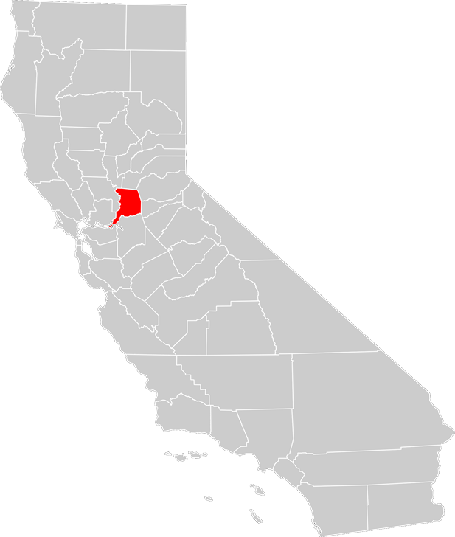
September 13, 2016
Environmental Management Department
CUPA
Programs
2026 Fee Proposal

Slide 2

Environmental Management Department
​The mission of the Sacramento County Environmental Management Department (EMD) is to protect public health and the environment by ensuring compliance with environmental regulations.
Notes:
WIFM: Friends/family first responders. Enjoy outdoor recreation (fishing, swimming, riding etc.). Sacramento County relies heavily on groundwater. CUPA Programs protect these.
Potential cost associated with non-compliance

Slide 3
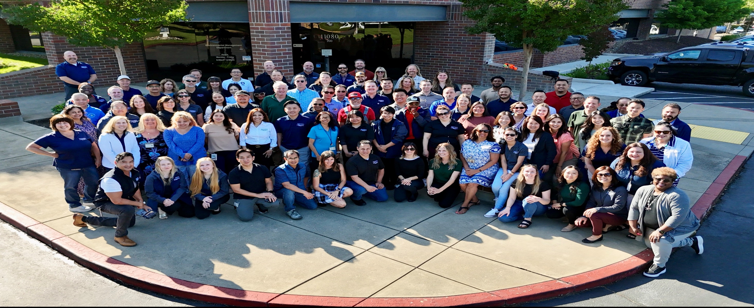
September 13, 2016
Environmental Management Department
31 Environmental Programs
Special Fund Department 100% fee supported
FY 2024-2025: over 28,000 inspections countywide
113 FTE specifically trained Environmental Specialists and support staff

Slide 4

Environmental Management Department
Above Ground Storage Tanks
Cal Accidental Release Prevention Program
Hazardous Materials Business Plan and Storage
Environmental Protection
Division
Hazardous Waste Storage and Generation
Underground Storage Tanks
Incident Response
Toxic Site Clean up
Wells
Abandoned Well Program
Cross Connection Control Program
Solid Waste Facilities
Land Use
Small Water System
Liquid Waste/Septic Systems
Recycled Water
Robert Duncan, Chief Environmental Protection
Stormwater
Notes:
WIFM: Friends/family first responders. Enjoy outdoor recreation (fishing, swimming, riding etc.). Sacramento County relies heavily on groundwater. CUPA Programs protect these.
Potential cost associated with non-compliance

Slide 5
Certified Unified Program Agency (CUPA)
Environmental Management Department
The Environmental Protection Division has been certified by the California Environmental Protection Agency (Cal-EPA) as the CUPA for Sacramento County. As the CUPA, EMD is responsible for the implementation of six statewide environmental programs for Sacramento County:
Aboveground Petroleum Storage Act (ASPA)
California Accidental Release Prevention (CalARP)
Hazardous Material Business Plan Program (HMP)
Hazardous Waste Management (HW)
Underground Storage Tanks (UST)
Tiered Permitting
Notes:
Discuss specialization needed for each program
APSA- All facilities that have ASTs (including 55 gallon drums) with an aggregate storage capacity of ≥1,320 gallons of petroleum are subject to APSA.
CalARP- A CalARP facility is a facility that handles, manufactures, uses, or stores any of the listed regulated substances found in CCR Title 19 tables 1-3 above threshold quantities.
HMBP- If your business handles and/or stores a hazardous material equal to or greater than 55 gallons for liquids, 500 pounds for solids and 200 cubic feet (at standard temperature and pressure) for compressed gases.
Hazwaste- Listed or characteristic
UST- Any tank and its associated piping (located substantially or totally underground) which is used for the storage of hazardous substances.
Tiered Permitting- State of California authorized hazardous waste treatment and storage program that matches each permitted tier with the degree of risk associated with the waste generators treatment or storage activities.

Slide 6
Certified Unified Program Agency (CUPA)
Environmental Management Department
Authorities:
  APSA (H&S Code*, § 25270.5, subd. (a));
  CalARP (H&S Code, § 25534.5);
  HMP (H&S Code, § 25508, subd. (a));
  HW (H&S Code, § 25185, subd. (a)); and
  UST (H&S Code, § 25289).
  *California Health & Safety Code
Notes:
HW is also the authority for the Tiered Permitting program. Also includes Fire Code but don’t have authority, make referrals to Sac Metro and City Fire Depts.

Slide 7
Environmental Management Department
The implementation of these programs involve
  A single fee system and consolidated permit for all Unified Program elements
  Inspection of regulated facilities
  Education of regulated businesses on requirements, laws, and regulations
  Investigations of complaints, spills, unauthorized releases, etc.
  Enforcement against facilities that have violated applicable laws and regulations

Slide 8
Services Provided
Environmental Management Department
Complaint response
On-call technical specialists
Plan/Document review
Online resources
Incident response team
Social media outreach
New/Existing Business Assistance
  Business Environmental Resource Center (BERC)
Notes:
Break into two
When an emergency happens you are prepared!!!

Slide 9
Sacramento County by the Numbers
Environmental Management Department
In Fiscal Year 2024-2025:
Over 9,500 permits issued
Over 2,700 inspections conducted
4,689 business plans reviewed
352 public records act requests: over 41,000 documents
447 UST inspections
241 UST Removals, Installations, Upgrades, and/or Repairs
575 incident response calls
Notes:
Cal ARP, Tiered Perm, APSA

Slide 10
27 CCR § 15220
Fee Accountability Program
Environmental Management Department
The fee accountability program shall include at a minimum the following elements:
Fee schedule, amount billed, and revenue collected
Staff work hours required to implement the program
Direct & indirect program expenses (disposable equipment or administrative functions)
Number of regulated facilities in each program element within the jurisdiction
Quantity and range of services provided
Notes:
§ 15220. Fee Accountability Program.
(a) Each CUPA shall implement a fee accountability program designed to encourage efficient and cost-effective operation of the program for which the single fee and surcharge are assessed.
(1) The fee accountability program shall be instituted before the single fee system. The fee accountability program shall include at a minimum the following elements:
(A) Accounting for: the fee schedule, the actual amount billed, and the revenue collected.
(B) Discrete billable services, categorized as either site specific or general.
(C) Staff work hours required to implement the program.
(D) Direct program expenses including durable and disposable equipment.
(E) Indirect program expenses including overhead for facilities and administrative functions.
(F) The number of regulated businesses in each program element within the jurisdiction.
(G) Total number of regulated businesses in the jurisdiction.
(H) Quantity and range of services provided, including frequency of inspection.
(2) The CUPA and PAs shall annually review and update the fee accountability program.
Note: Authority cited: Sections 25404, 25404(b), 25404.5, 25404.5(b) and (c) and 25404.6(c), Health and Safety Code. Reference: Sections 25404.1(a)(1), 25404.4 and 25404.5, Health and Safety Code.

Slide 11
Proposed Fee Changes
Environmental Management Department
Fees are either a 1 year or 2 year phase-in
  10% of all CUPA program subcategories will be affected by the fee increase (7 out of 72)
Two new proposed fees
  UST – Vapor, Pressure, Hydrostatic (VPH) Surcharge
  Administrative Processing Fee for Permit Payment Plans
Fees may increase annually pursuant to the US Western Region Consumer Price Index
Notes:
Summarize before tables

Slide 12

Hazardous Material Business Plan Program (HMP)
Environmental Management Department
H&SC Chapter 6.95 & Title 19 CCR
Facilities storing reportable quantities of Hazardous Materials
Dedicated business plan review team
Inspected every three years
HMBP workshops
  Call to schedule (916) 875-8550
CA Environmental Reporting System (CERS) Hotline 916-875-2377
Specialized Programs = Specialized Staff
Notes:
HMBP- If your business handles and/or stores a hazardous material equal to or greater than 55 gallons for liquids, 500 pounds for solids and 200 cubic feet (at standard temperature and pressure) for compressed gases. Equivalent to the Federal Emergency Planning and Community Right to Know Act (EPCRA) Tier II reporting.

Slide 13
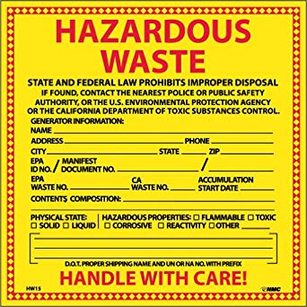
Hazardous Waste Management (HW) & Tiered Permitting
Environmental Management Department
H&SC Chapter 6.5 & Title 22 CCR pursuant to 40 CFR part 262
Facilities that generate/treat hazardous waste onsite
Activity specific, risk based permitting program
Complex regulations
Extensive document review
Inspected every three years
Specialized Programs = Specialized Staff
Notes:
Hazwaste- Listed or characteristic
Tiered Permitting- State of California authorized hazardous waste treatment and storage program that matches each permitted tier with the degree of risk associated with the waste generators treatment or storage activities.

Slide 14
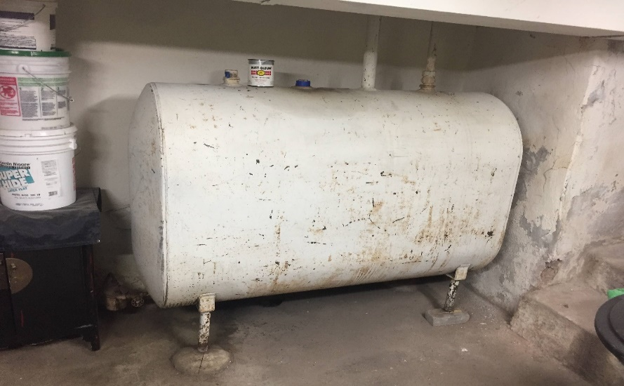
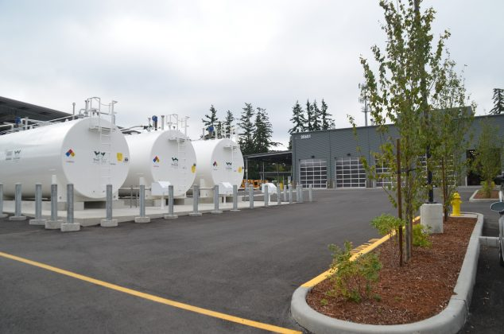
​Aboveground Petroleum Storage Act (ASPA)
Environmental Management Department
H&SC Chapter 6.67 pursuant to 40 CFR 112.7
Facilities storing petroleum in quantities greater than 1,320 gallons
In-depth review of the Spill Prevention Control and Countermeasures Plan (SPCC) and compliance with industry standards
Trained Inspectors (Steel Tank Institute SP001 Certified)
Facilities inspected/verified every three years
Specialized Programs = Specialized Staff
Notes:
Inspector must be certified. Continuous-ed credits may be required in the future. Only inspect/verify facilities with petroleum total shell capacity greater than 1320 gallons.

Slide 15
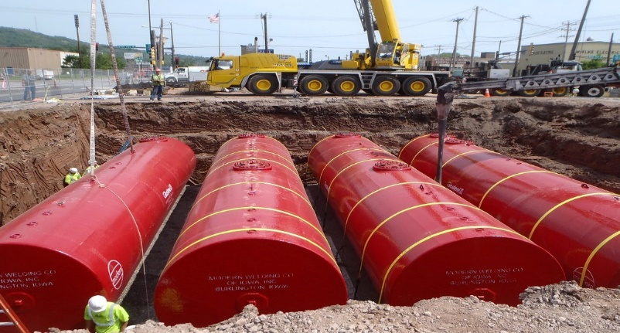
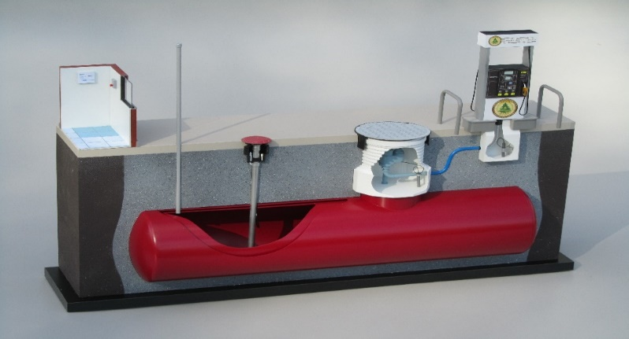
Underground Storage Tanks (UST)
Environmental Management Department
H&SC Chapter 6.7, Title 23 CCR
Facilities that store hazardous materials in underground tanks
International Code Council (ICC) Certified - Continuous education
Construction - New installation, repairs, & upgrades
Removal - Initial & ongoing monitoring
Annual inspection
UST CERS Submittal Workshops
  Call to schedule 916-875-8550
Specialized Programs = Specialized Staff
Notes:
UST- Any tank and its associated piping (located substantially or totally underground) which is used for the storage of hazardous substances.

Slide 16
Why is a Fee Adjustment Needed?
Environmental Management Department
EMD receives no General Funds (100% fee funded)
Required fee accountability program per Title 27 of CCR
  § 15220. Fee Accountability Program.
  (a) Each CUPA shall implement a fee accountability program designed to encourage efficient and cost-effective operation of the program for which the single fee and surcharge are assessed.
Notes:
The Environmental Management Department (EMD) did not raise fees this fiscal year (2019-20). For businesses permitted under the Environmental Compliance Division, this was the 9th straight year fees have remained unchanged. Starting in April 2019, EMD contracted an independent third party to perform a fee study to determine the correct fees that would fully cost recover for the required inspections and services. EMD is scheduled to adopt this fee schedule starting fiscal year 2020-2021.
Starting November 2019, EMD will be holding public workshops to learn about the new fees, have questions answered, and give feedback about how the fees may impact them.
EMD will continue with its commitment to utilize technology and develop efficient processes to provide excellent customer service and reduce operating costs.
-EMD is fully cost recovered by fees for services and permits-Receives no General Funding
-EMD is committed to protecting public health and the environment
-Permit fees are calculated to recover program administration costs
-Some fee categories will see an increase and other will remain the same
-EC overall: 127 fees will see an increase and 77 will remain the same. The total number of fee categories is 204
-3 year phased-in approach for most permit fees. Some will be phased in over 5 years
-Anticipated that fees will be effective July 2020
Other counties that have increased CUPA program fees this last FY:
-San Diego
-Placer
-San Joaquin
-San Francisco

Slide 17
Sacramento County CUPA (HMP)
Proposed Two Year Phase-In Plan
Description | Current (2025) Fee | Effective July 2026 | Effective July 2027
Hazardous Materials in Reportable Quantity – Hazardous Waste Only | $405 | $473 | $538

Slide 18
Sacramento County CUPA (HW)
Proposed One Year Phase-In Plan
Description | Current (2025) Fee | Effective July 2026
Hazardous Waste Generator Fee - < 55 Gallons | $375 | $413

Slide 19
Sacramento County CUPA (APSA)
Proposed Two Year Phase-In Plan
Description | Current (2025) Fee | Effective July 2026 | Effective July 2027
Aboveground Storage Tank: 1,320 to < 10,000 Gallons | $422 | $546 | $667

Slide 20
Sacramento County CUPA (UST)
Proposed One Year Phase-In Plan
Description | Current (2025) Fee | Effective July 2026
Underground Storage Tank Fee – 1 Tank | $2,283 | $2,441
Underground Storage Tank Fee – 2 Tanks | $2,493 | $2,648

Slide 21
Sacramento County CUPA (UST)
Proposed Three Year Phase-In Plan
Description | Current (2025) Fee | Effective July 2026 | Effective July 2027 | Effective July 2028
Underground Storage Tank – VPH Surcharge | New Fee | $299 | $456 | $683

Slide 22
Notes:
Average $1,976
One UST system

Slide 23
Notes:
Average $1,976
One UST system

Slide 24
Notes:
Average $1,976
One UST system

Slide 25
Notes:
Average $1,976
One UST system

Slide 26
Summary and Additional Notes
Environmental Management Department
Phased in approach for ease in fee adjustments
Two new fees for UST-VPH and Payment Plan processing
Fees may increase annually pursuant to the US Western Region Consumer Price Index
Stay up to date with future outreach or compliance tools available to you:
www.emd.saccounty.gov

Slide 27
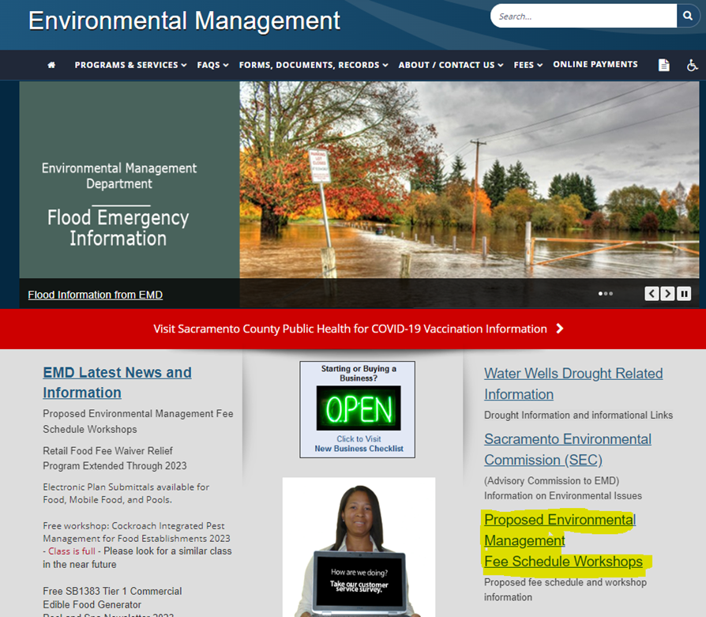
Environmental Management Department

Slide 28

Questions
Environmental Management Department
James Van Buren
vanburenj@saccounty.gov
(916) 661-7585
https://emd.saccounty.gov/

